Slide 1

GEO Knowledge Hub to preserve and share EO Applications: Introduction and practice
Visão geral sobre análise de dados
GEO Knowledge Hub team
Date: 5th of October from 11:15 to 12:00
Where: Open Earth Monitor – Global Workshop 2023 (Bolzano / Italy)

Slide 2



GEO Knowledge Hub team
Kalamkas Yessimkhanova
Paola de Salvo
Felipe Carlos
We are not alone! Our team thanks everyone who worked with us, especially Gilberto Camara, Douglas Cripe, Gilberto Queiroz, Florian Franziskakis, Hendrik Baeyens, and the InvenioRDM community
Open Earth Monitor Workshop 2023
GEO Knowledge Hub to preserve and share EO Applications

Slide 3

Material availability
All the materials used during this workshop are available in the following GitHub repository:
geo-knowledge-hub/geo-knowledge-hub-workshop
Open Earth Monitor Workshop 2023
GEO Knowledge Hub to preserve and share EO Applications

Slide 4

Group on Earth Observations (GEO)
GEO is a partnership of more than 110 national governments and in excess of 100 Participating Organizations
Open Earth Monitor Workshop 2023
GEO Knowledge Hub to preserve and share EO Applications

Slide 5
Group on Earth Observations (GEO)
GEO envisions a future where decisions and actions for the benefit of humankind are informed by coordinated, comprehensive and sustained Earth observations
Open Earth Monitor Workshop 2023
GEO Knowledge Hub to preserve and share EO Applications

Slide 6
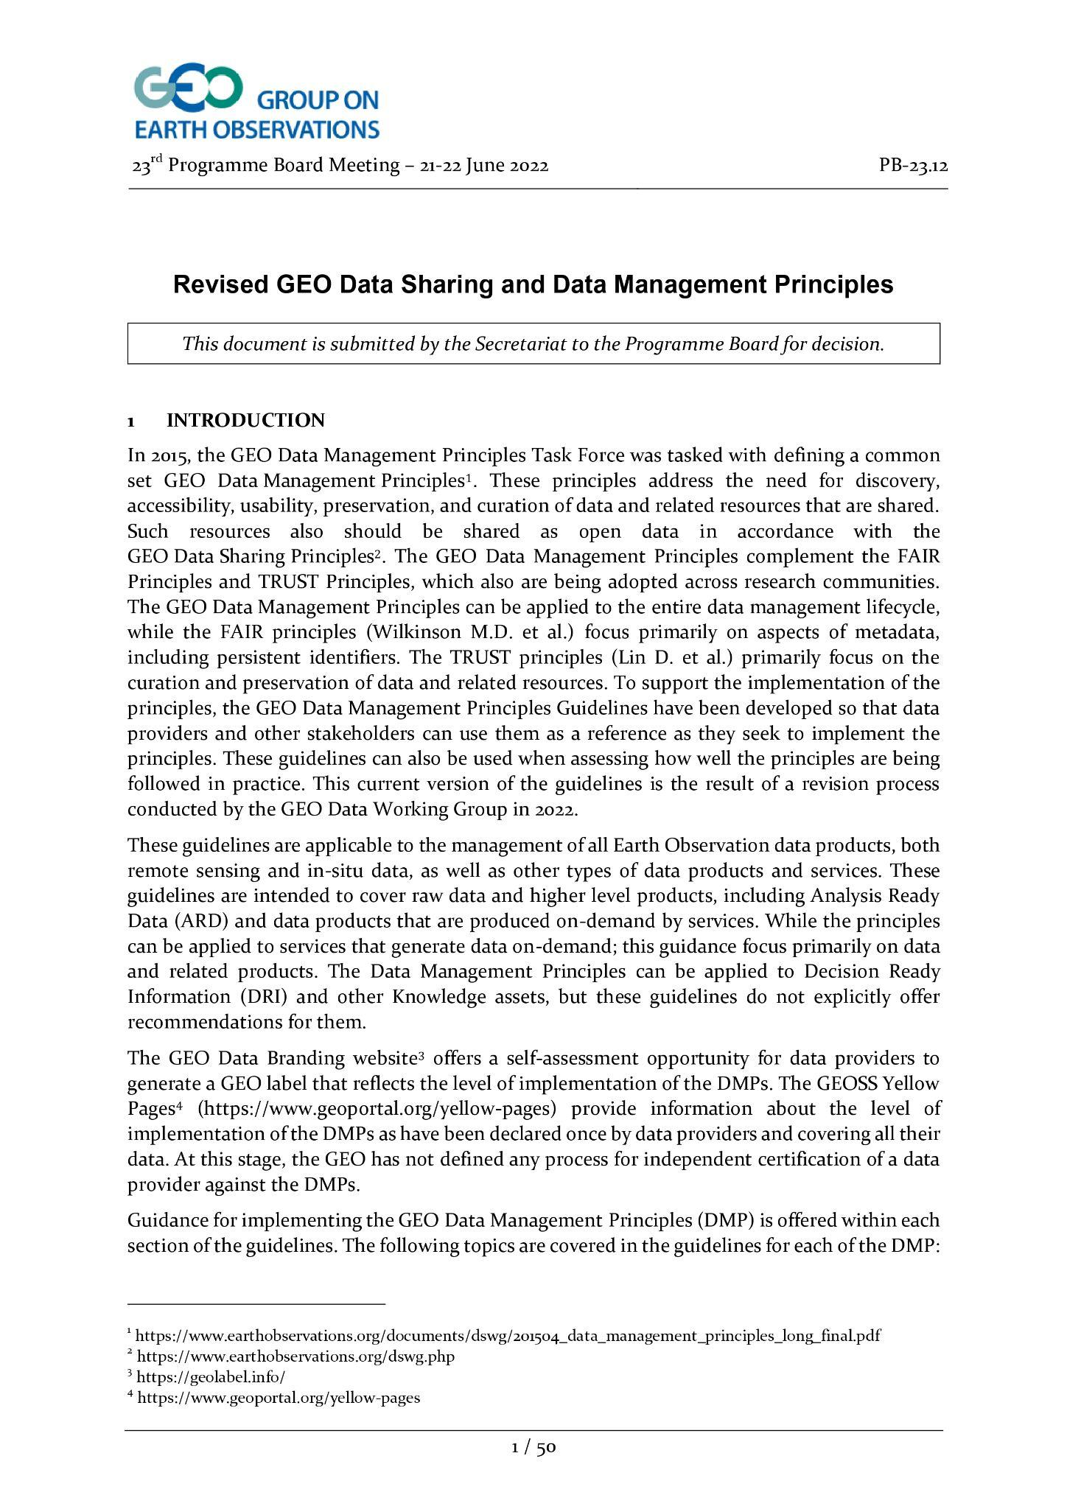
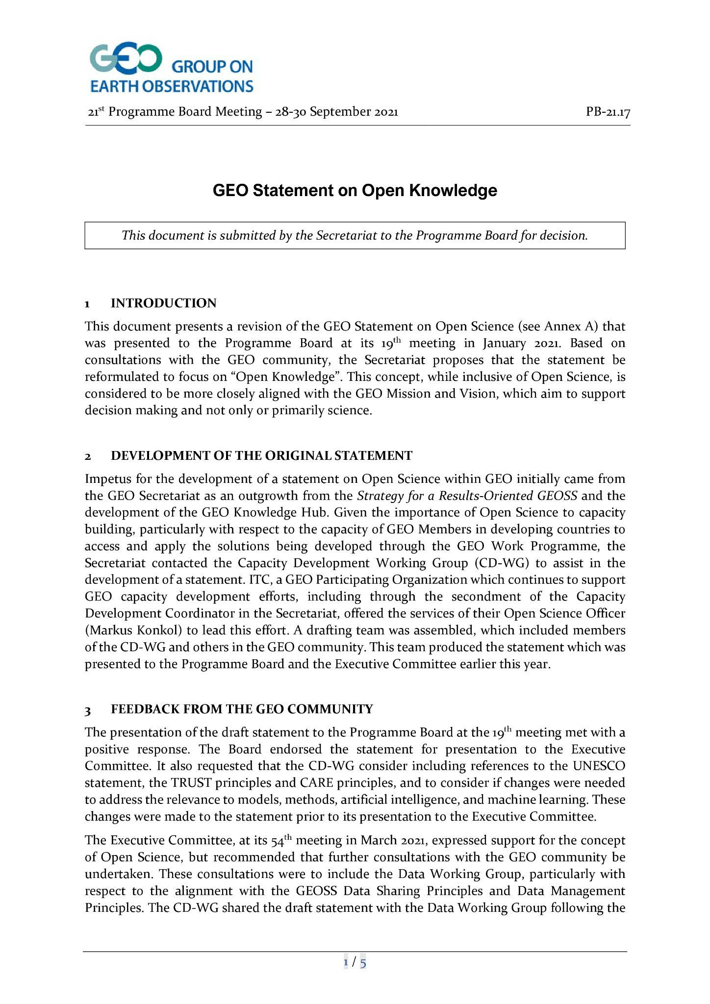
Group on Earth Observations (GEO)
GEO Data Sharing principles
Open Knowledge Statement
Open Earth Monitor Workshop 2023
GEO Knowledge Hub to preserve and share EO Applications

Slide 7
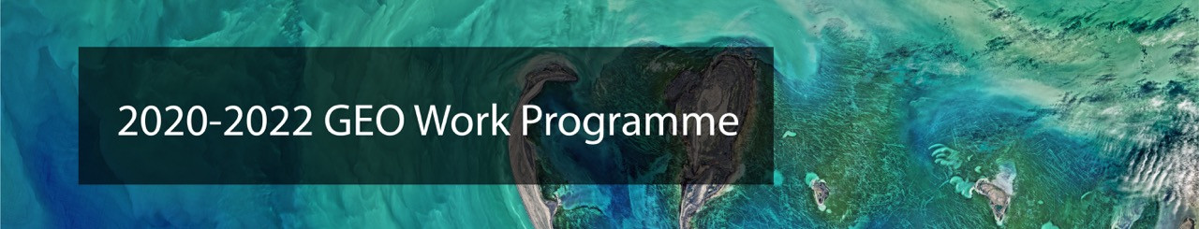
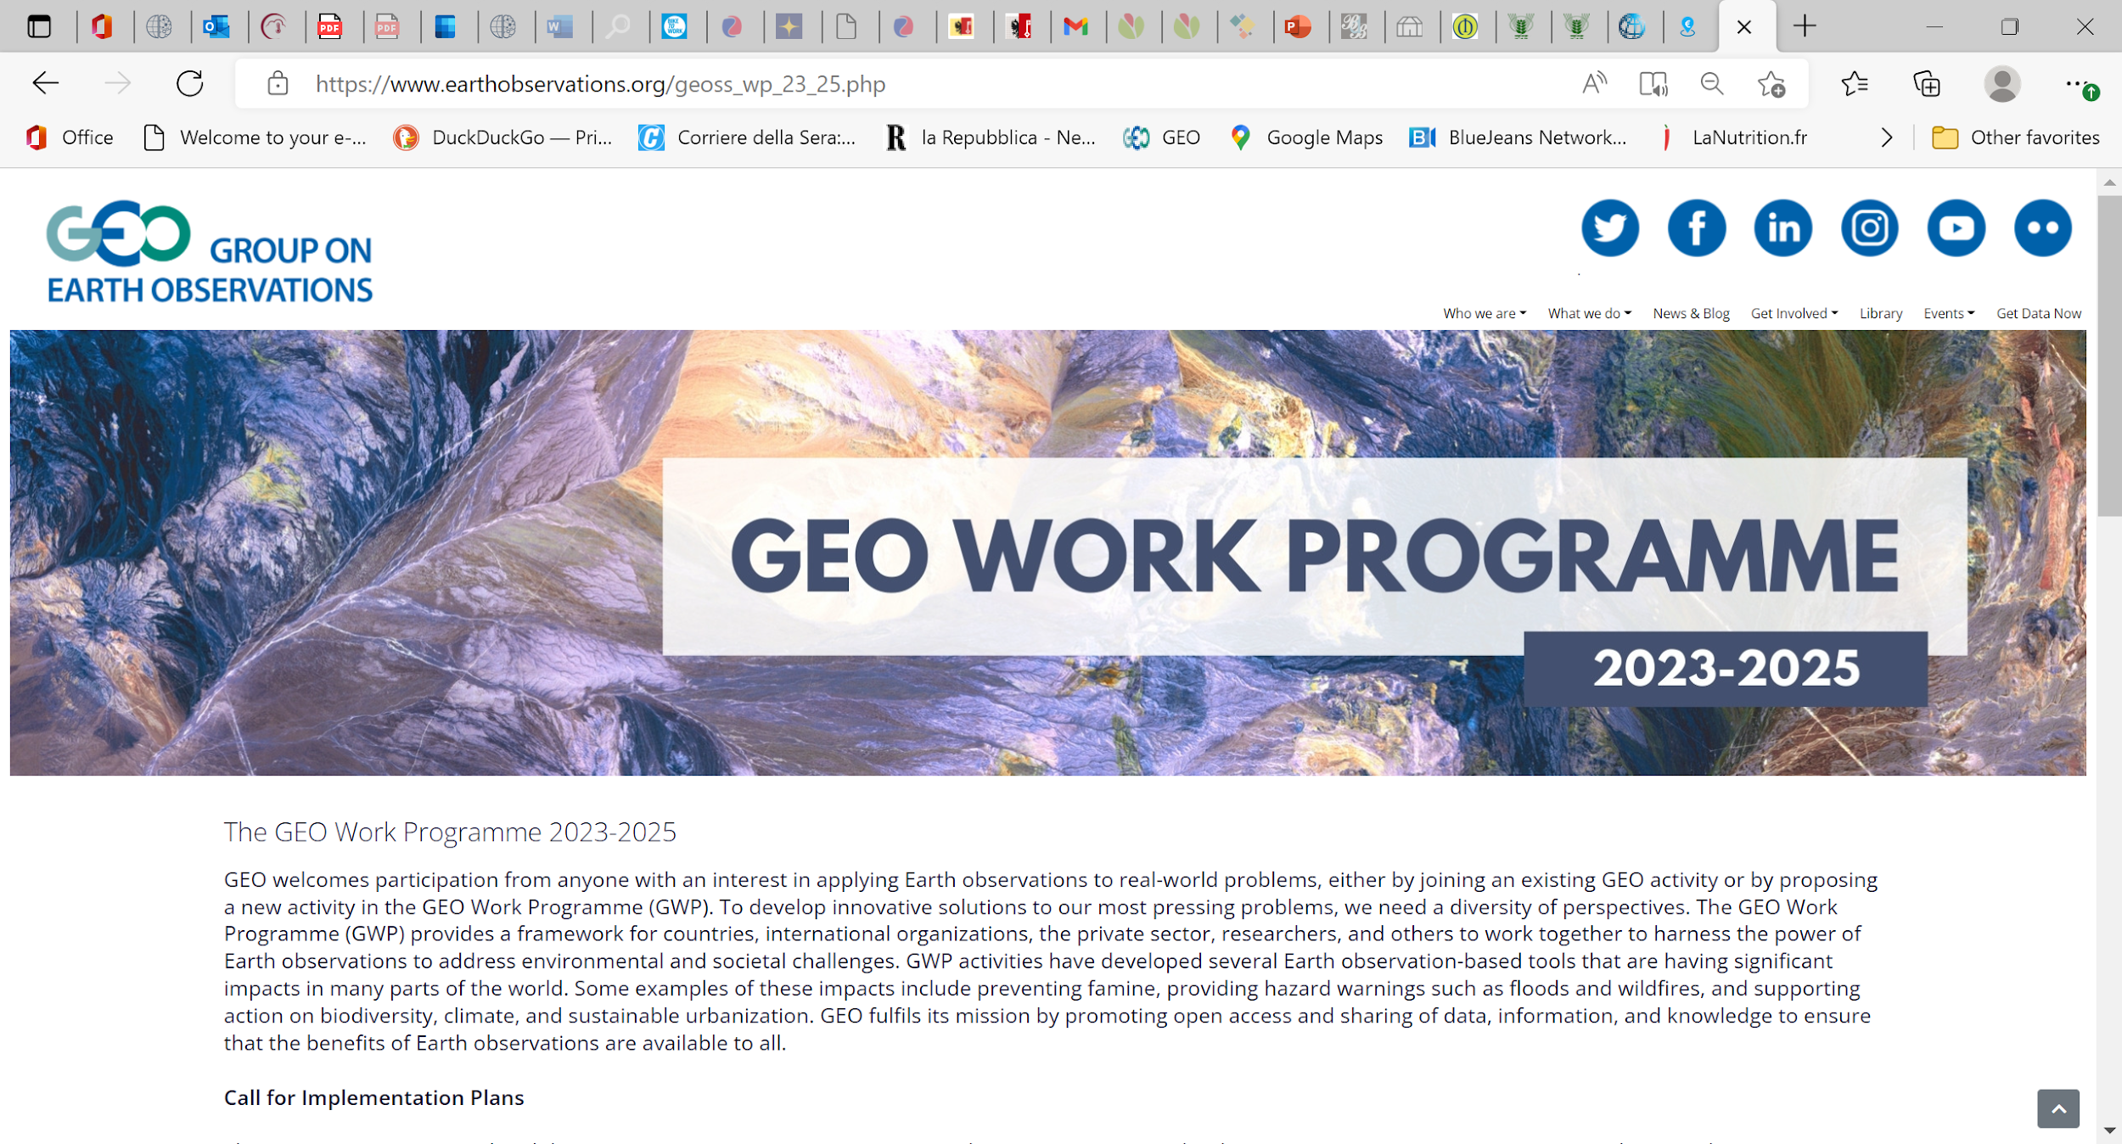
Group on Earth Observations (GEO)
Download the GEO Work Programme 2023-2025 Summary Document, which contains short descriptions of each of the GEO Flagships, Initiatives, Pilot Initiatives and Regional GEOs that comprise the GEO Work Programme.
Open Earth Monitor Workshop 2023
GEO Knowledge Hub to preserve and share EO Applications

Slide 8

Open Earth Monitor Workshop 2023
GEO Knowledge Hub to preserve and share EO Applications

Slide 9
The GEO Knowledge Hub is a digital library for the GEO Community
Open Earth Monitor Workshop 2023
GEO Knowledge Hub to preserve and share EO Applications

Slide 10
GEO Knowledge Hub
Open Earth Monitor Workshop 2023
GEO Knowledge Hub to preserve and share EO Applications

Slide 11
GEO Knowledge Hub
Helps the GEO Community to share EO Applications
Open Earth Monitor Workshop 2023
GEO Knowledge Hub to preserve and share EO Applications

Slide 12
GEO Knowledge Hub
Helps the GEO Community to share EO Applications
Preserves materials from the EO Applications
Open Earth Monitor Workshop 2023
GEO Knowledge Hub to preserve and share EO Applications

Slide 13
GEO Knowledge Hub
Helps the GEO Community to share EO Applications
Preserves materials from the EO Applications
Helps the community to find and access EO Applications
Open Earth Monitor Workshop 2023
GEO Knowledge Hub to preserve and share EO Applications

Slide 14

Knowledge Packages
Open Earth Monitor Workshop 2023
GEO Knowledge Hub to preserve and share EO Applications

Slide 15
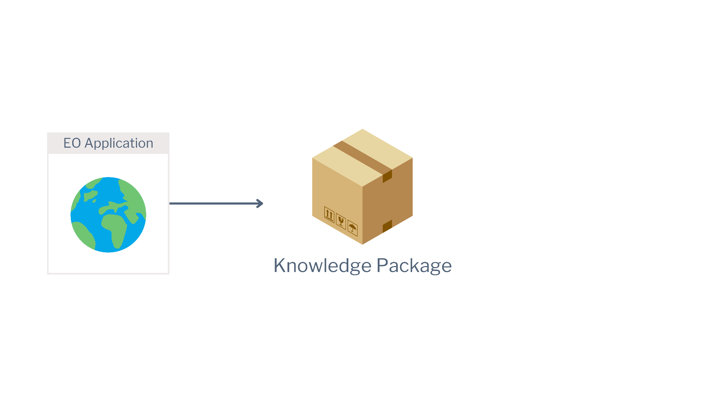
Knowledge Packages
Open Earth Monitor Workshop 2023
GEO Knowledge Hub to preserve and share EO Applications

Slide 16
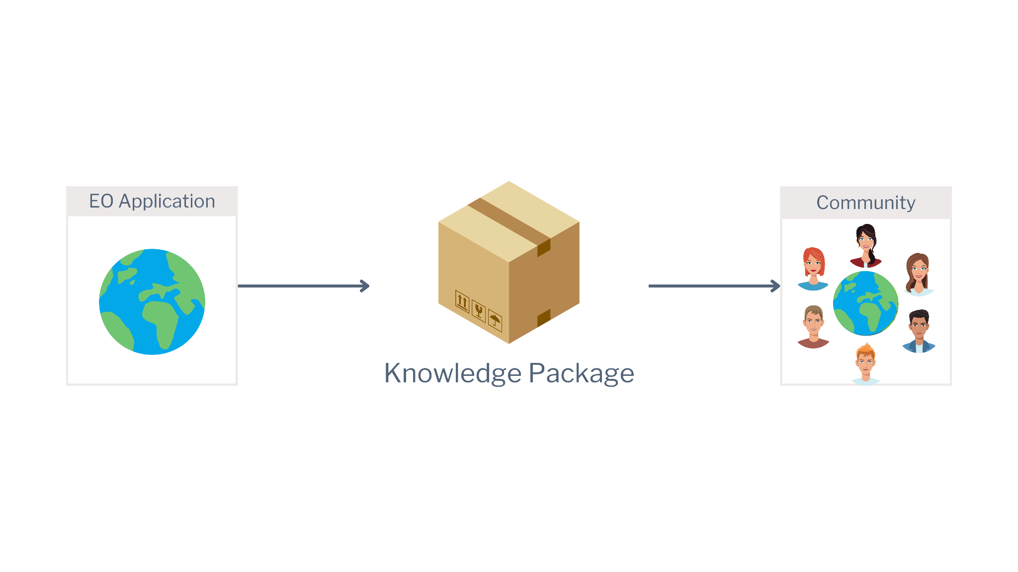
Knowledge Packages
Open Earth Monitor Workshop 2023
GEO Knowledge Hub to preserve and share EO Applications

Slide 17

Knowledge Packages
Open Earth Monitor Workshop 2023
GEO Knowledge Hub to preserve and share EO Applications

Slide 18
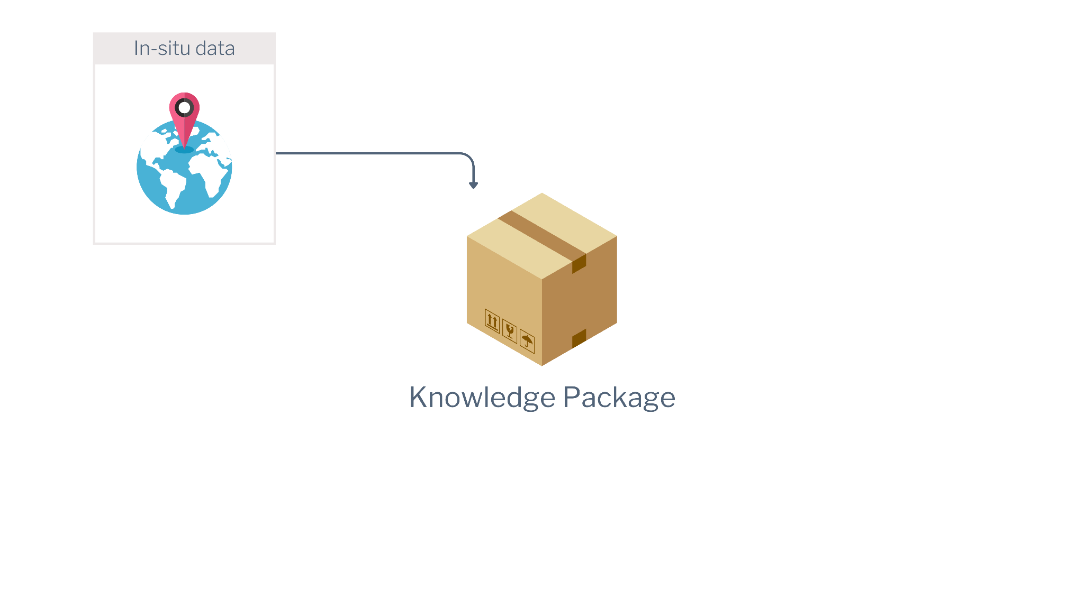
Knowledge Packages
Open Earth Monitor Workshop 2023
GEO Knowledge Hub to preserve and share EO Applications

Slide 19
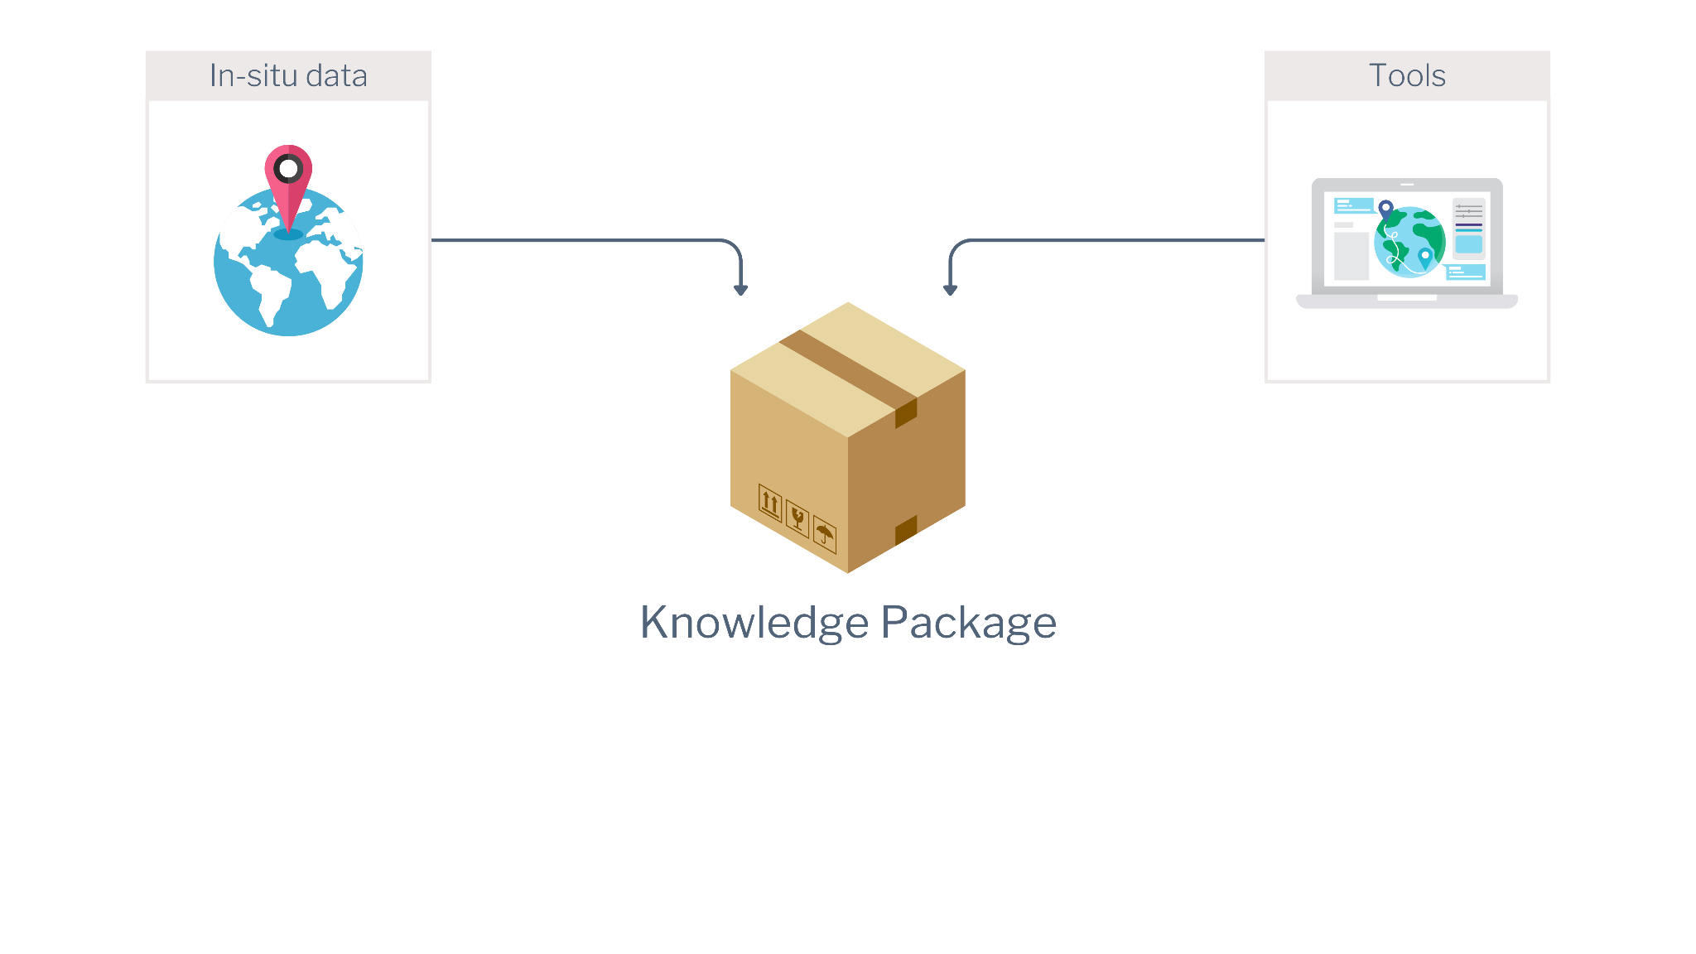
Knowledge Packages
Open Earth Monitor Workshop 2023
GEO Knowledge Hub to preserve and share EO Applications

Slide 20
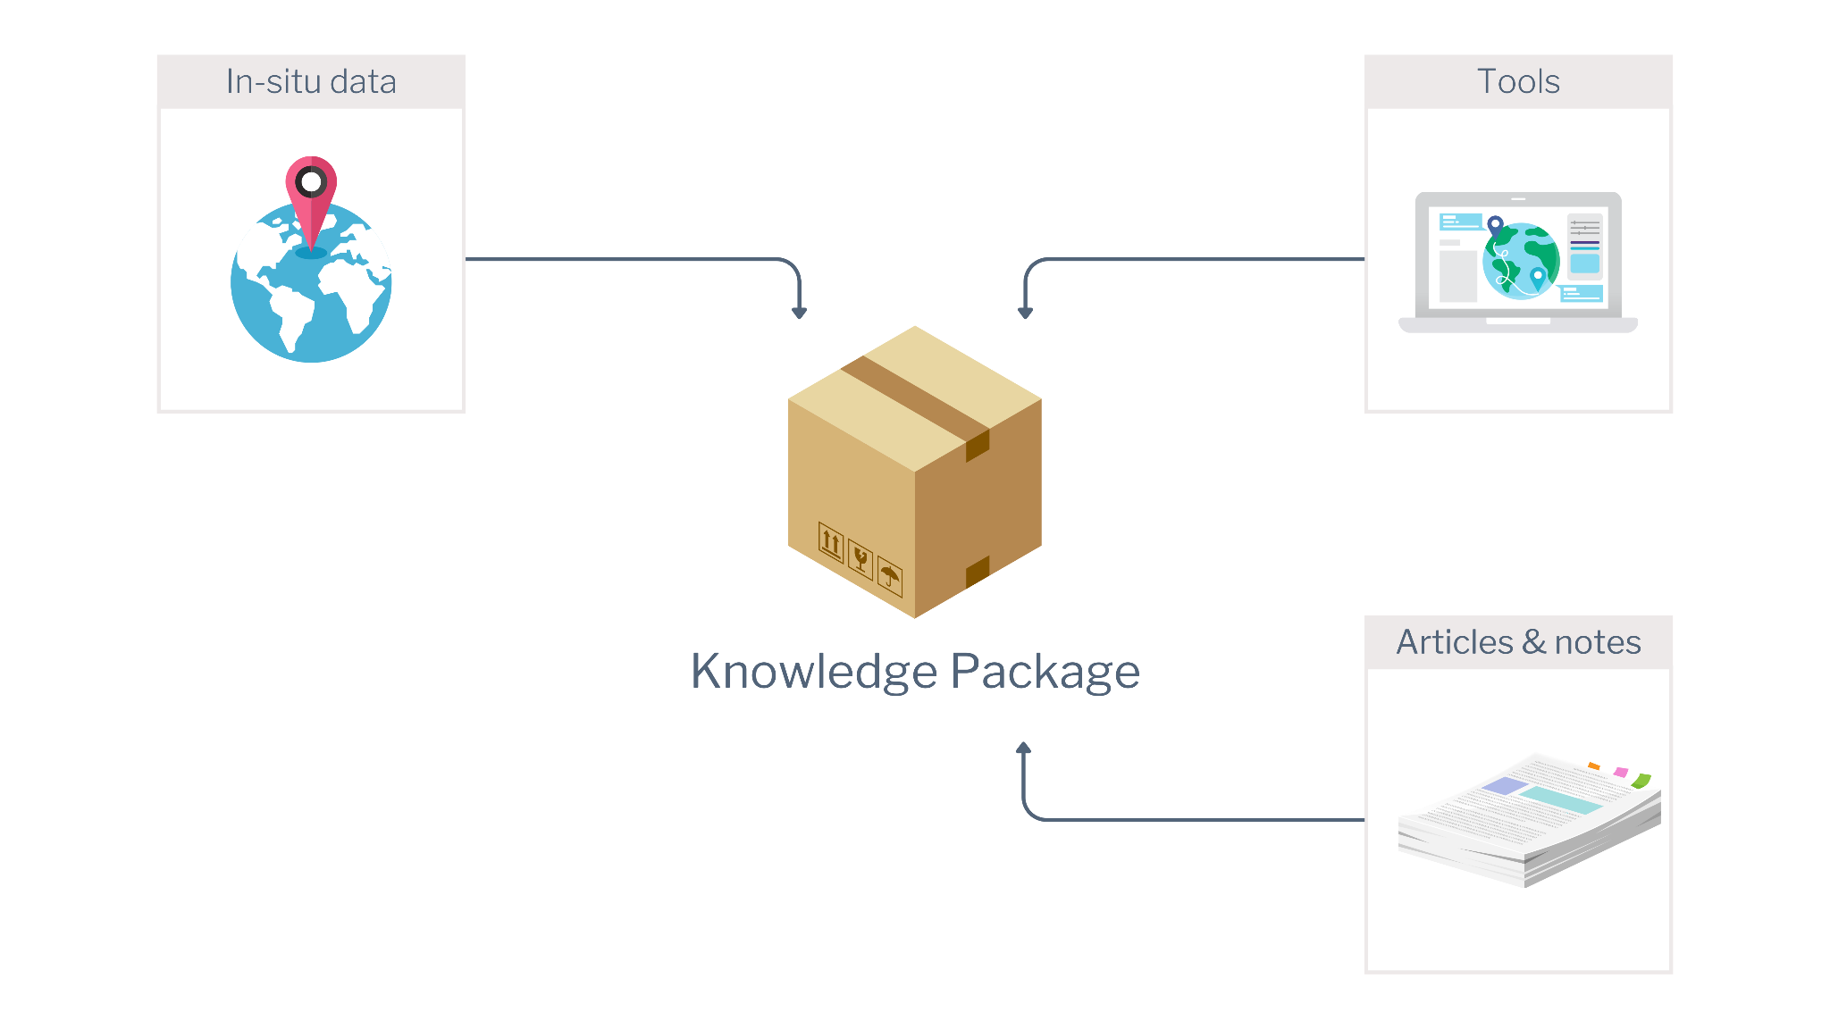
Knowledge Packages
Open Earth Monitor Workshop 2023
GEO Knowledge Hub to preserve and share EO Applications

Slide 21
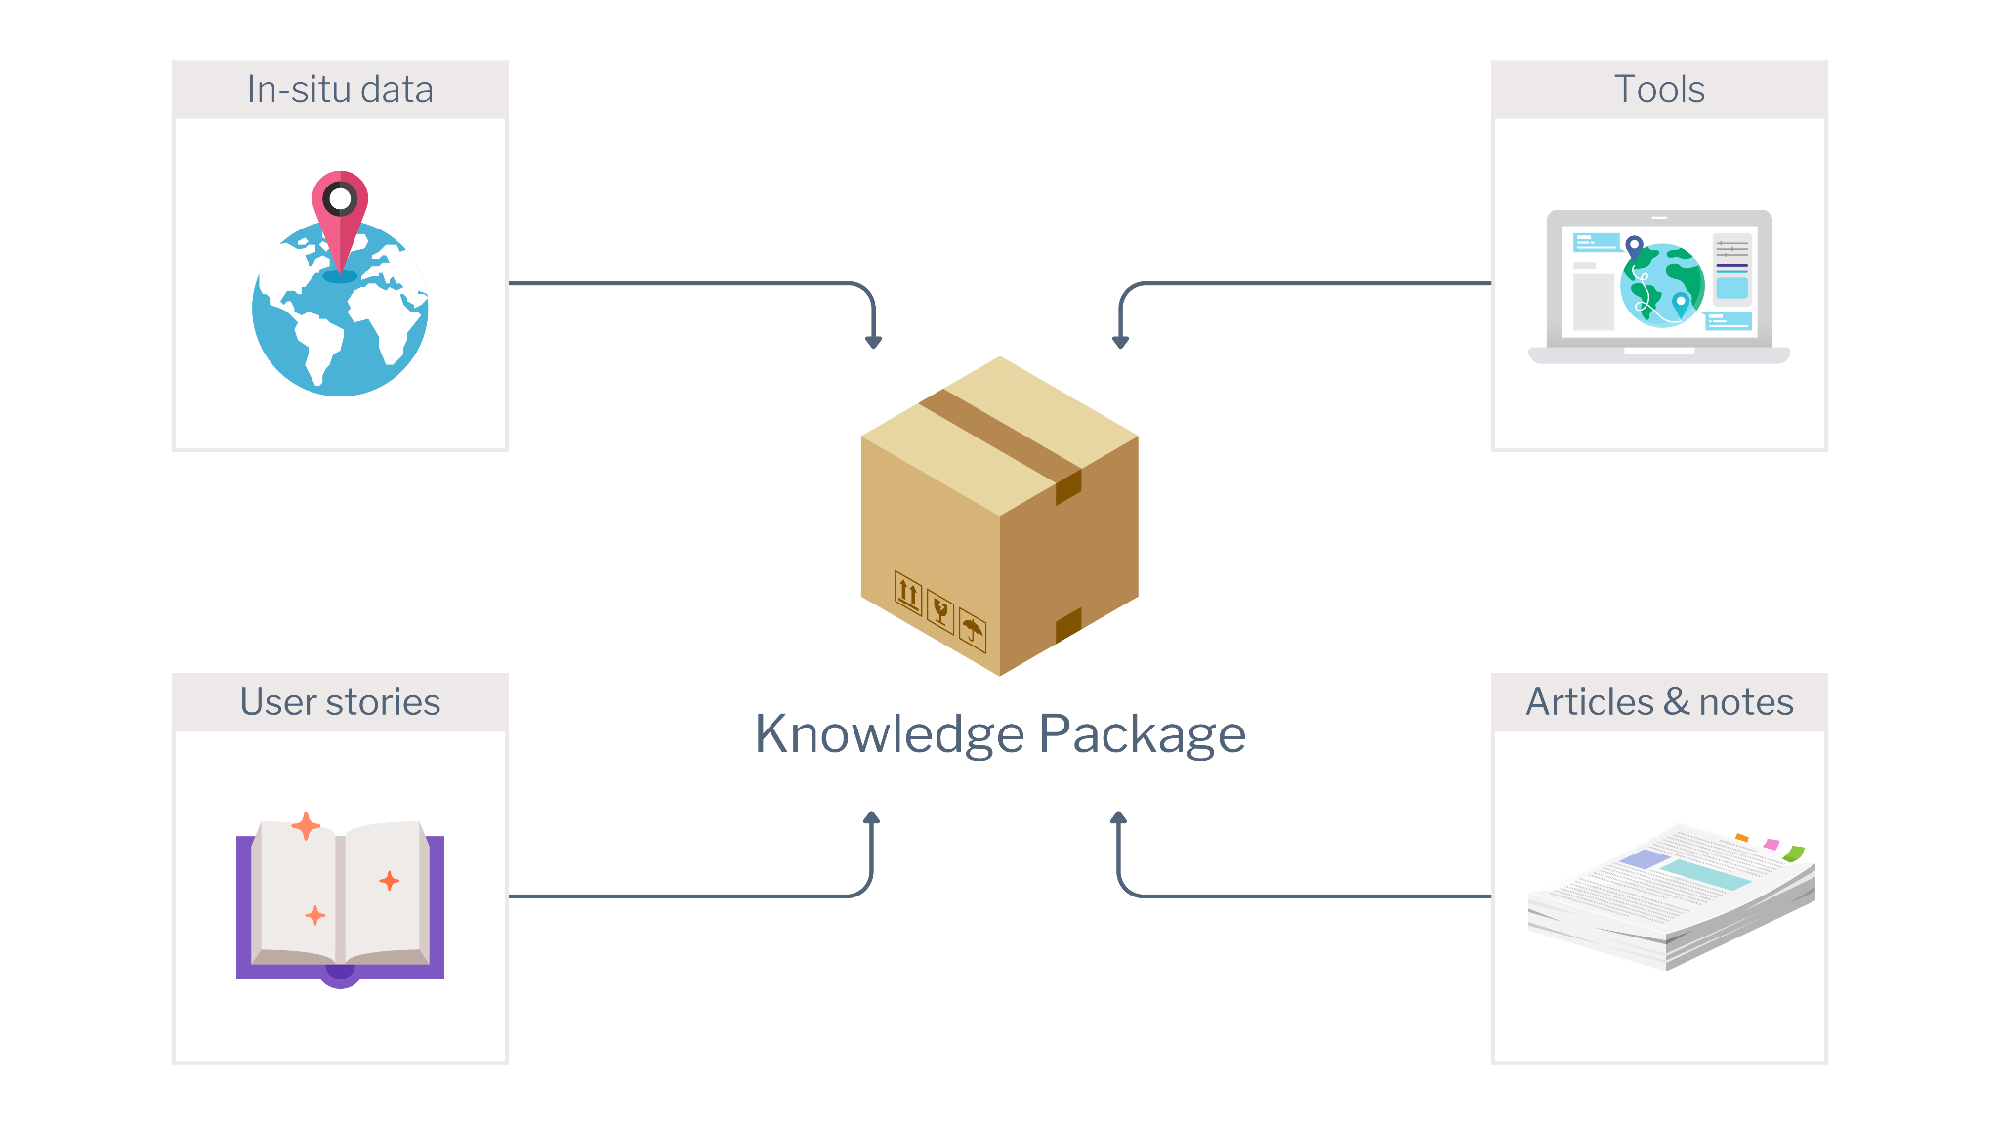
Knowledge Packages
Open Earth Monitor Workshop 2023
GEO Knowledge Hub to preserve and share EO Applications

Slide 22

Knowledge Packages
Open Earth Monitor Workshop 2023
GEO Knowledge Hub to preserve and share EO Applications

Slide 23

Knowledge Packages
Open Earth Monitor Workshop 2023
GEO Knowledge Hub to preserve and share EO Applications

Slide 24
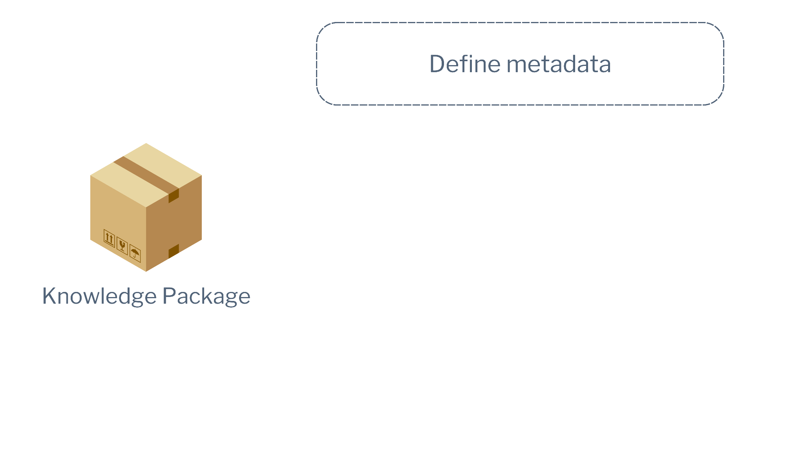
Knowledge Packages
Open Earth Monitor Workshop 2023
GEO Knowledge Hub to preserve and share EO Applications

Slide 25
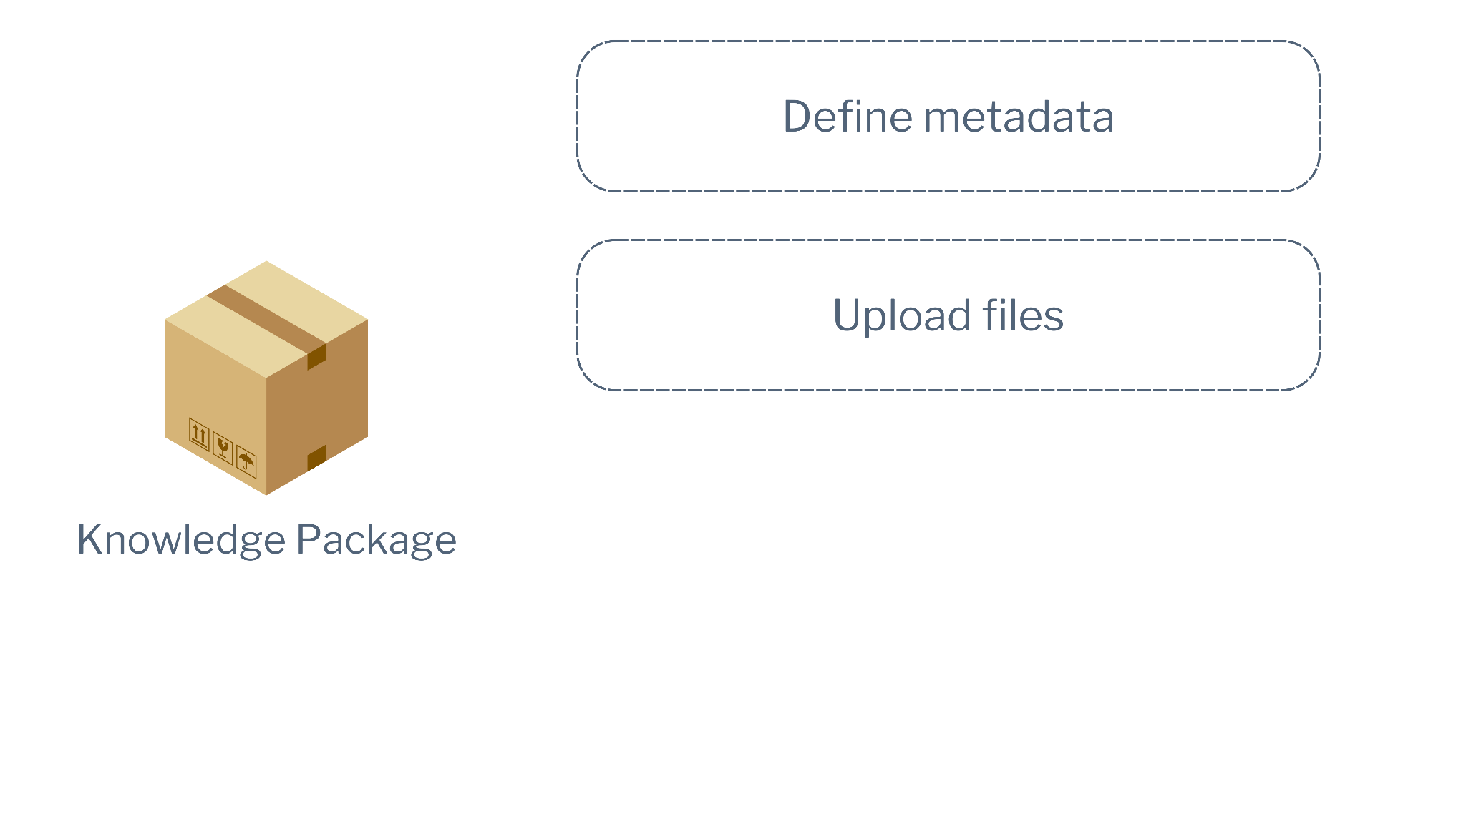
Knowledge Packages
Open Earth Monitor Workshop 2023
GEO Knowledge Hub to preserve and share EO Applications

Slide 26
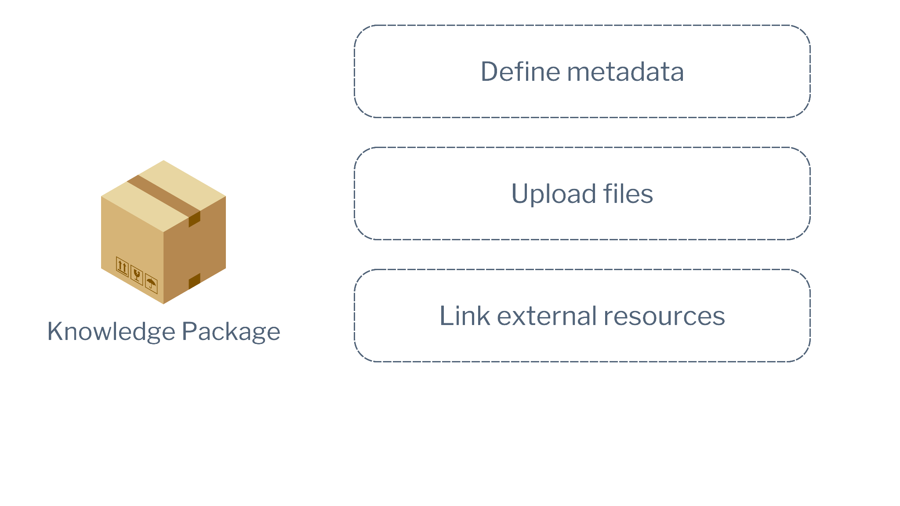
Knowledge Packages
Open Earth Monitor Workshop 2023
GEO Knowledge Hub to preserve and share EO Applications

Slide 27
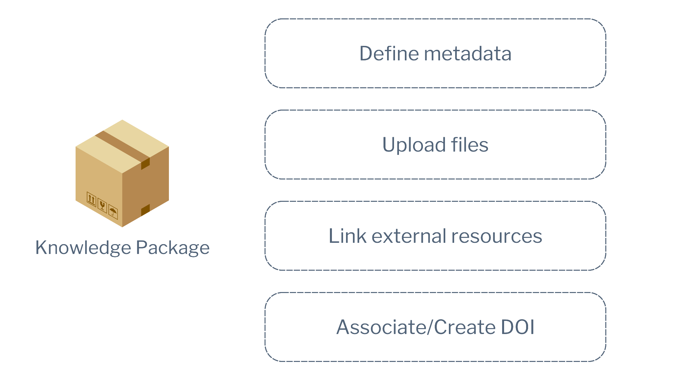
Knowledge Packages
Open Earth Monitor Workshop 2023
GEO Knowledge Hub to preserve and share EO Applications

Slide 28

Knowledge Packages
Open Earth Monitor Workshop 2023
GEO Knowledge Hub to preserve and share EO Applications

Slide 29
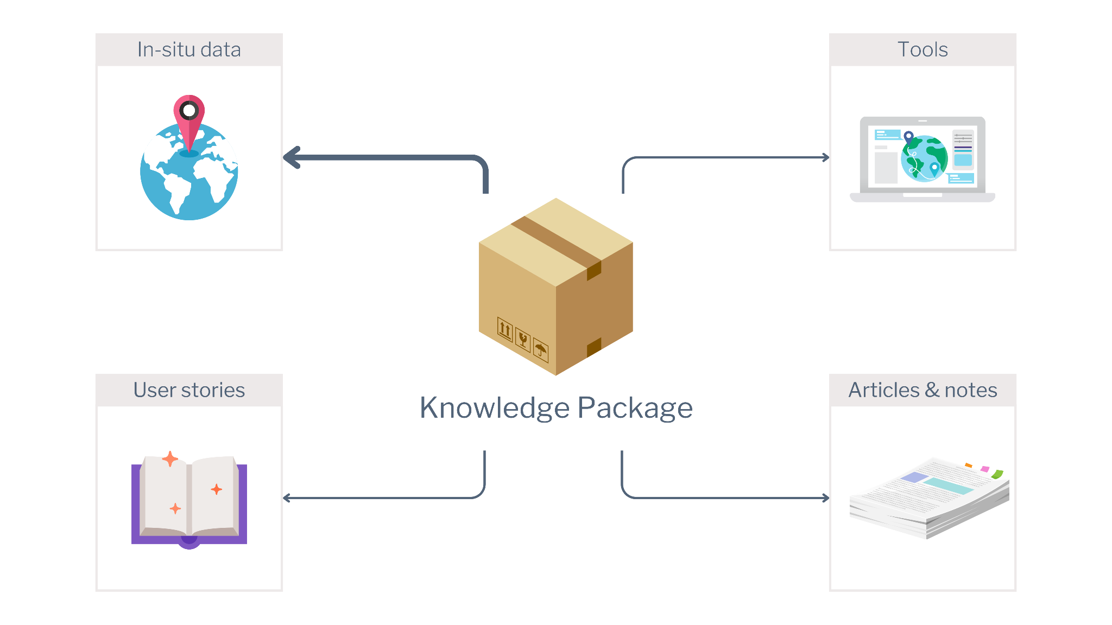
Knowledge Packages
Open Earth Monitor Workshop 2023
GEO Knowledge Hub to preserve and share EO Applications

Slide 30
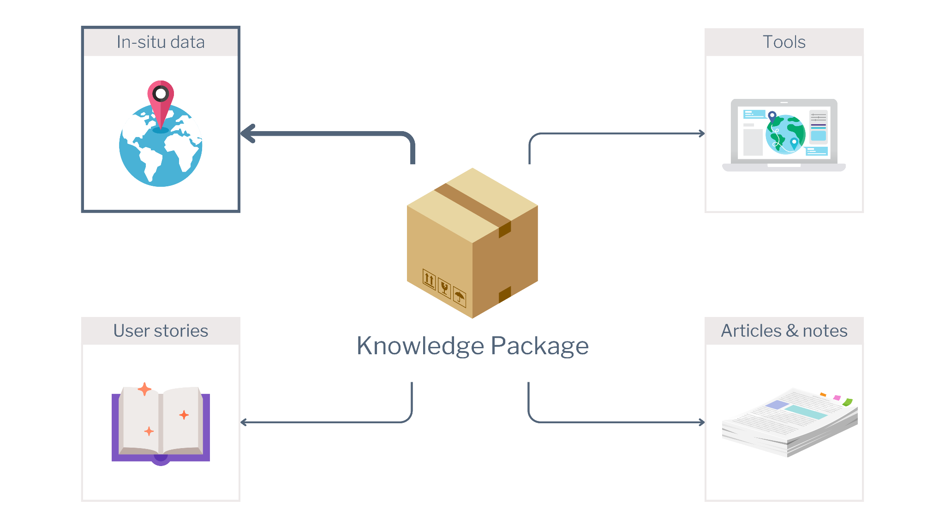
Knowledge Packages
Open Earth Monitor Workshop 2023
GEO Knowledge Hub to preserve and share EO Applications

Slide 31
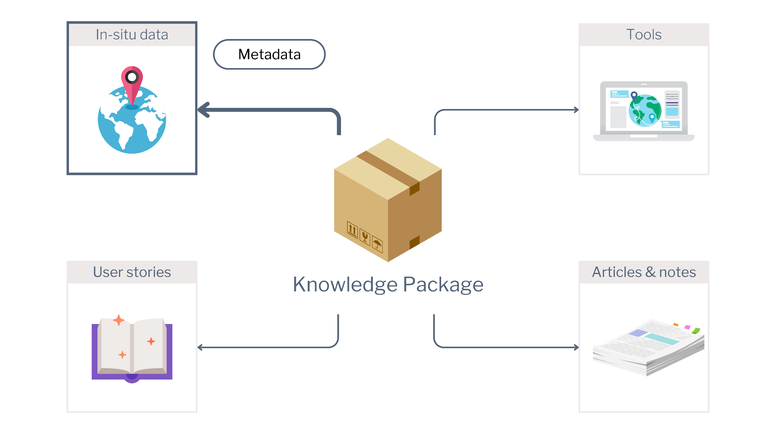
Knowledge Packages
Open Earth Monitor Workshop 2023
GEO Knowledge Hub to preserve and share EO Applications

Slide 32
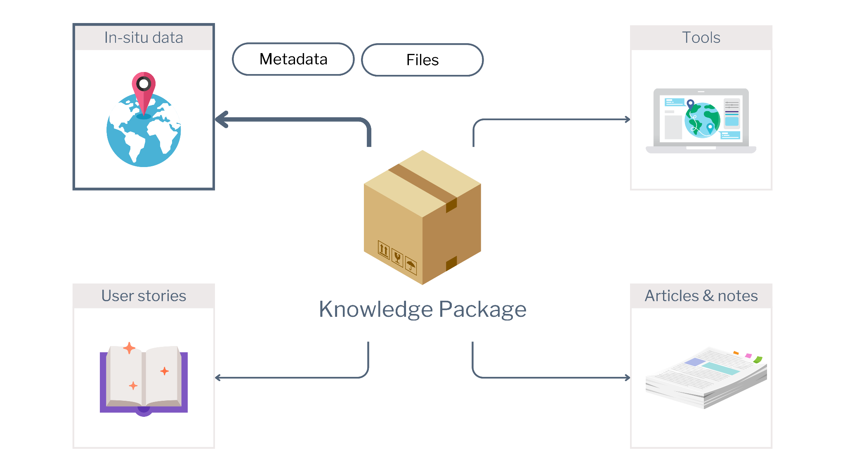
Knowledge Packages
Open Earth Monitor Workshop 2023
GEO Knowledge Hub to preserve and share EO Applications

Slide 33
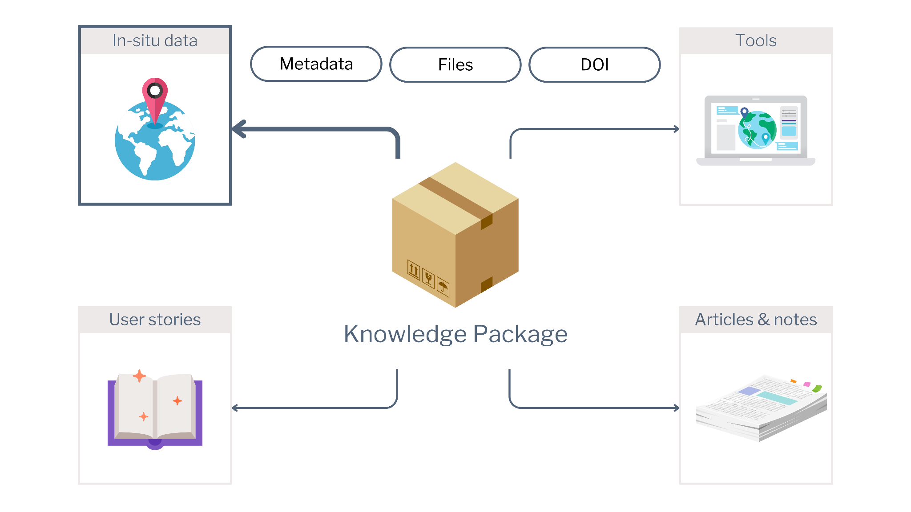
Knowledge Packages
Open Earth Monitor Workshop 2023
GEO Knowledge Hub to preserve and share EO Applications

Slide 34
Knowledge Package example
Open Earth Monitor Workshop 2023
GEO Knowledge Hub to preserve and share EO Applications

Slide 35

Monitoring Mangrove Extent in Africa using Digital Earth Africa Data Cube
Open Earth Monitor Workshop 2023
GEO Knowledge Hub to preserve and share EO Applications

Slide 36
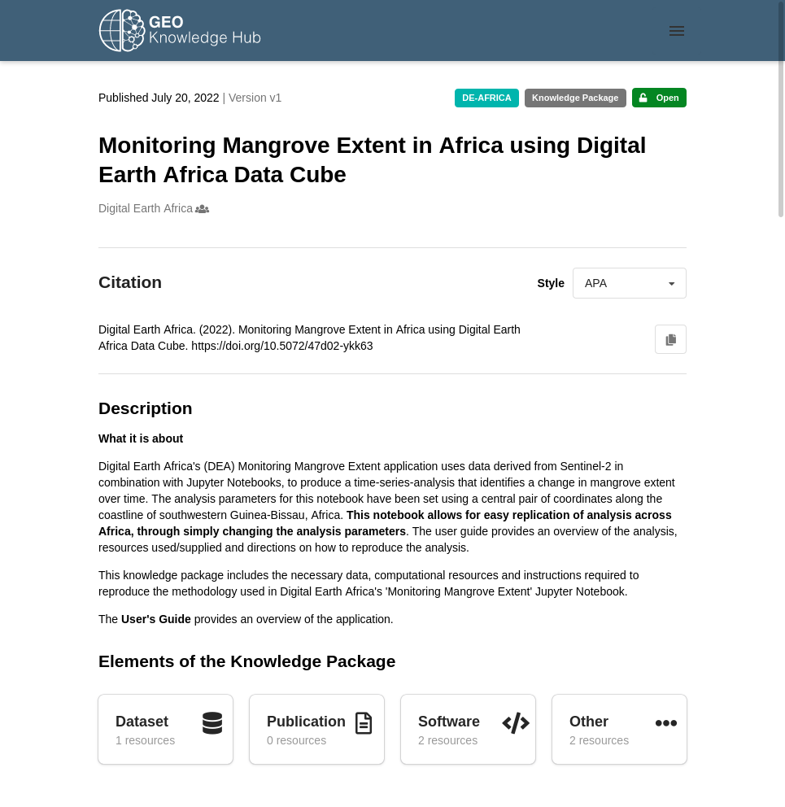

Monitoring Mangrove Extent in Africa using Digital Earth Africa Data Cube
Open Earth Monitor Workshop 2023
GEO Knowledge Hub to preserve and share EO Applications

Slide 37
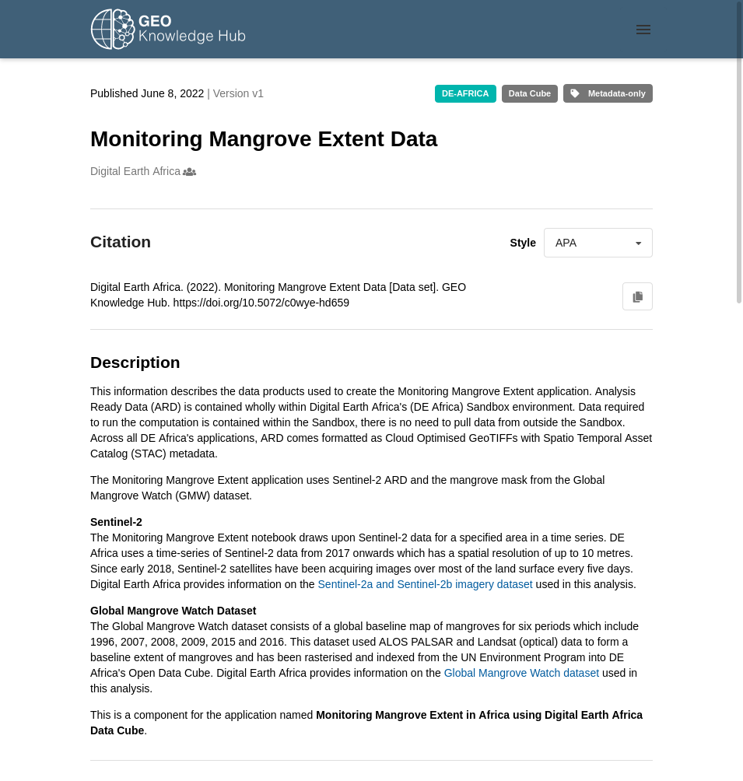
Monitoring Mangrove Extent in Africa using Digital Earth Africa Data Cube
Knowledge Resources
Open Earth Monitor Workshop 2023
GEO Knowledge Hub to preserve and share EO Applications

Slide 38
Monitoring Mangrove Extent in Africa using Digital Earth Africa Data Cube
Resources content
Knowledge Resources
Open Earth Monitor Workshop 2023
GEO Knowledge Hub to preserve and share EO Applications

Slide 39
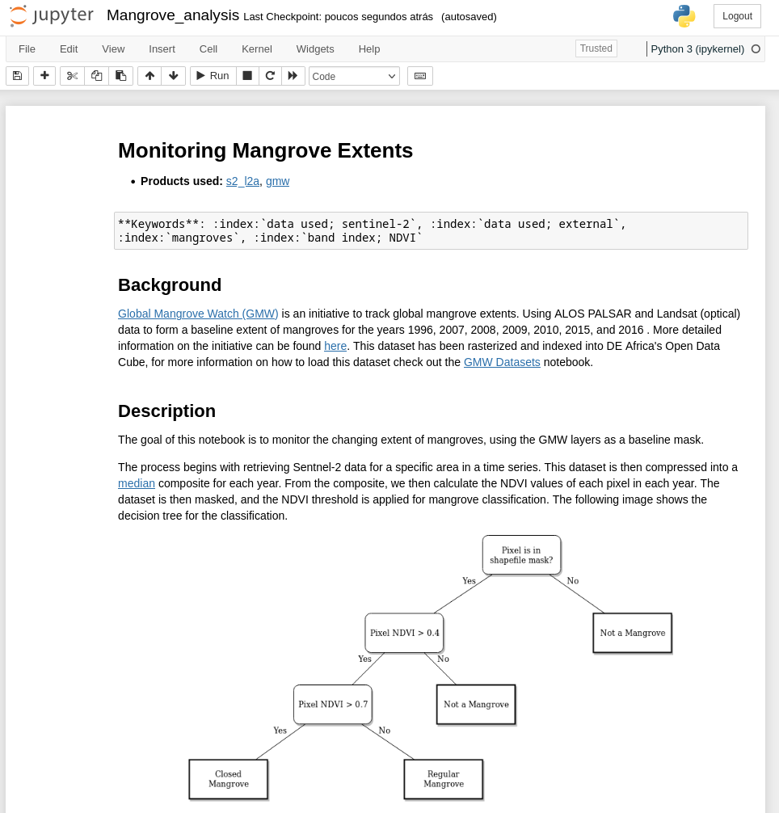
Monitoring Mangrove Extent in Africa using Digital Earth Africa Data Cube
Resources content
Executable
Notebook
Knowledge Resources
Open Earth Monitor Workshop 2023
GEO Knowledge Hub to preserve and share EO Applications

Slide 40
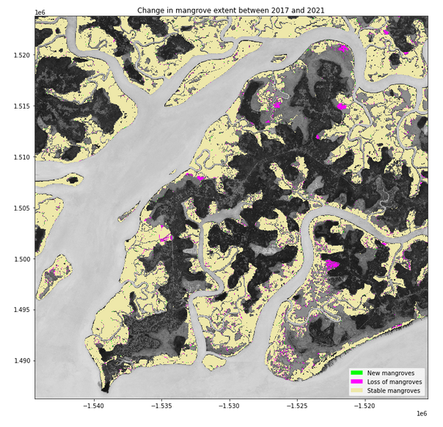
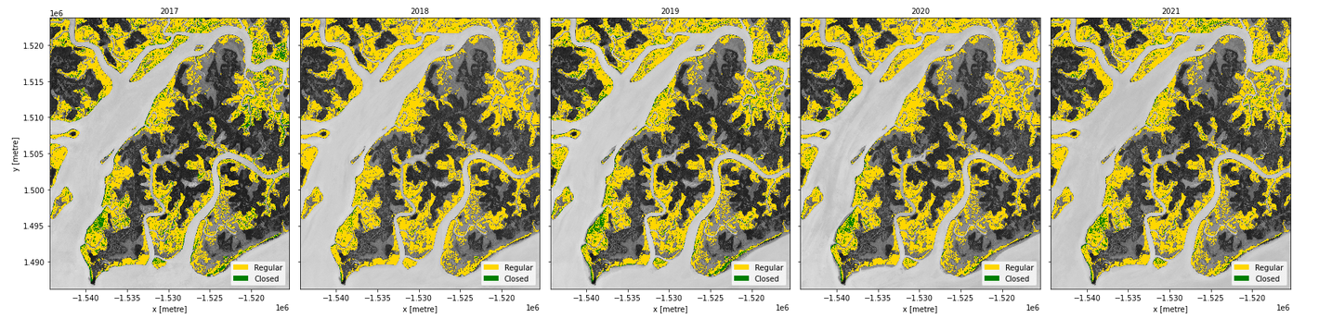
Monitoring Mangrove Extent in Africa using Digital Earth Africa Data Cube
Resources content
Executable
Notebook
Knowledge Resources
Auxiliary data and files
Open Earth Monitor Workshop 2023
GEO Knowledge Hub to preserve and share EO Applications

Slide 41
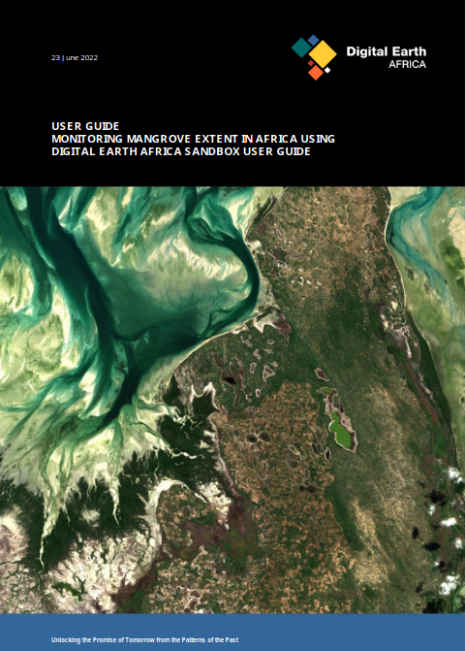
Monitoring Mangrove Extent in Africa using Digital Earth Africa Data Cube
Resources content
Executable
Notebook
Knowledge Resources
Auxiliary data and files
Description documents
Open Earth Monitor Workshop 2023
GEO Knowledge Hub to preserve and share EO Applications

Slide 42
Users
Open Earth Monitor Workshop 2023
GEO Knowledge Hub to preserve and share EO Applications

Slide 43



Users
User
Knowledge Packages
Open Earth Monitor Workshop 2023
GEO Knowledge Hub to preserve and share EO Applications

Slide 44


Users
User
Knowledge Providers
Knowledge Packages
Knowledge Packages
Open Earth Monitor Workshop 2023
GEO Knowledge Hub to preserve and share EO Applications

Slide 45

We build together with the community
Open Earth Monitor Workshop 2023
GEO Knowledge Hub to preserve and share EO Applications

Slide 46
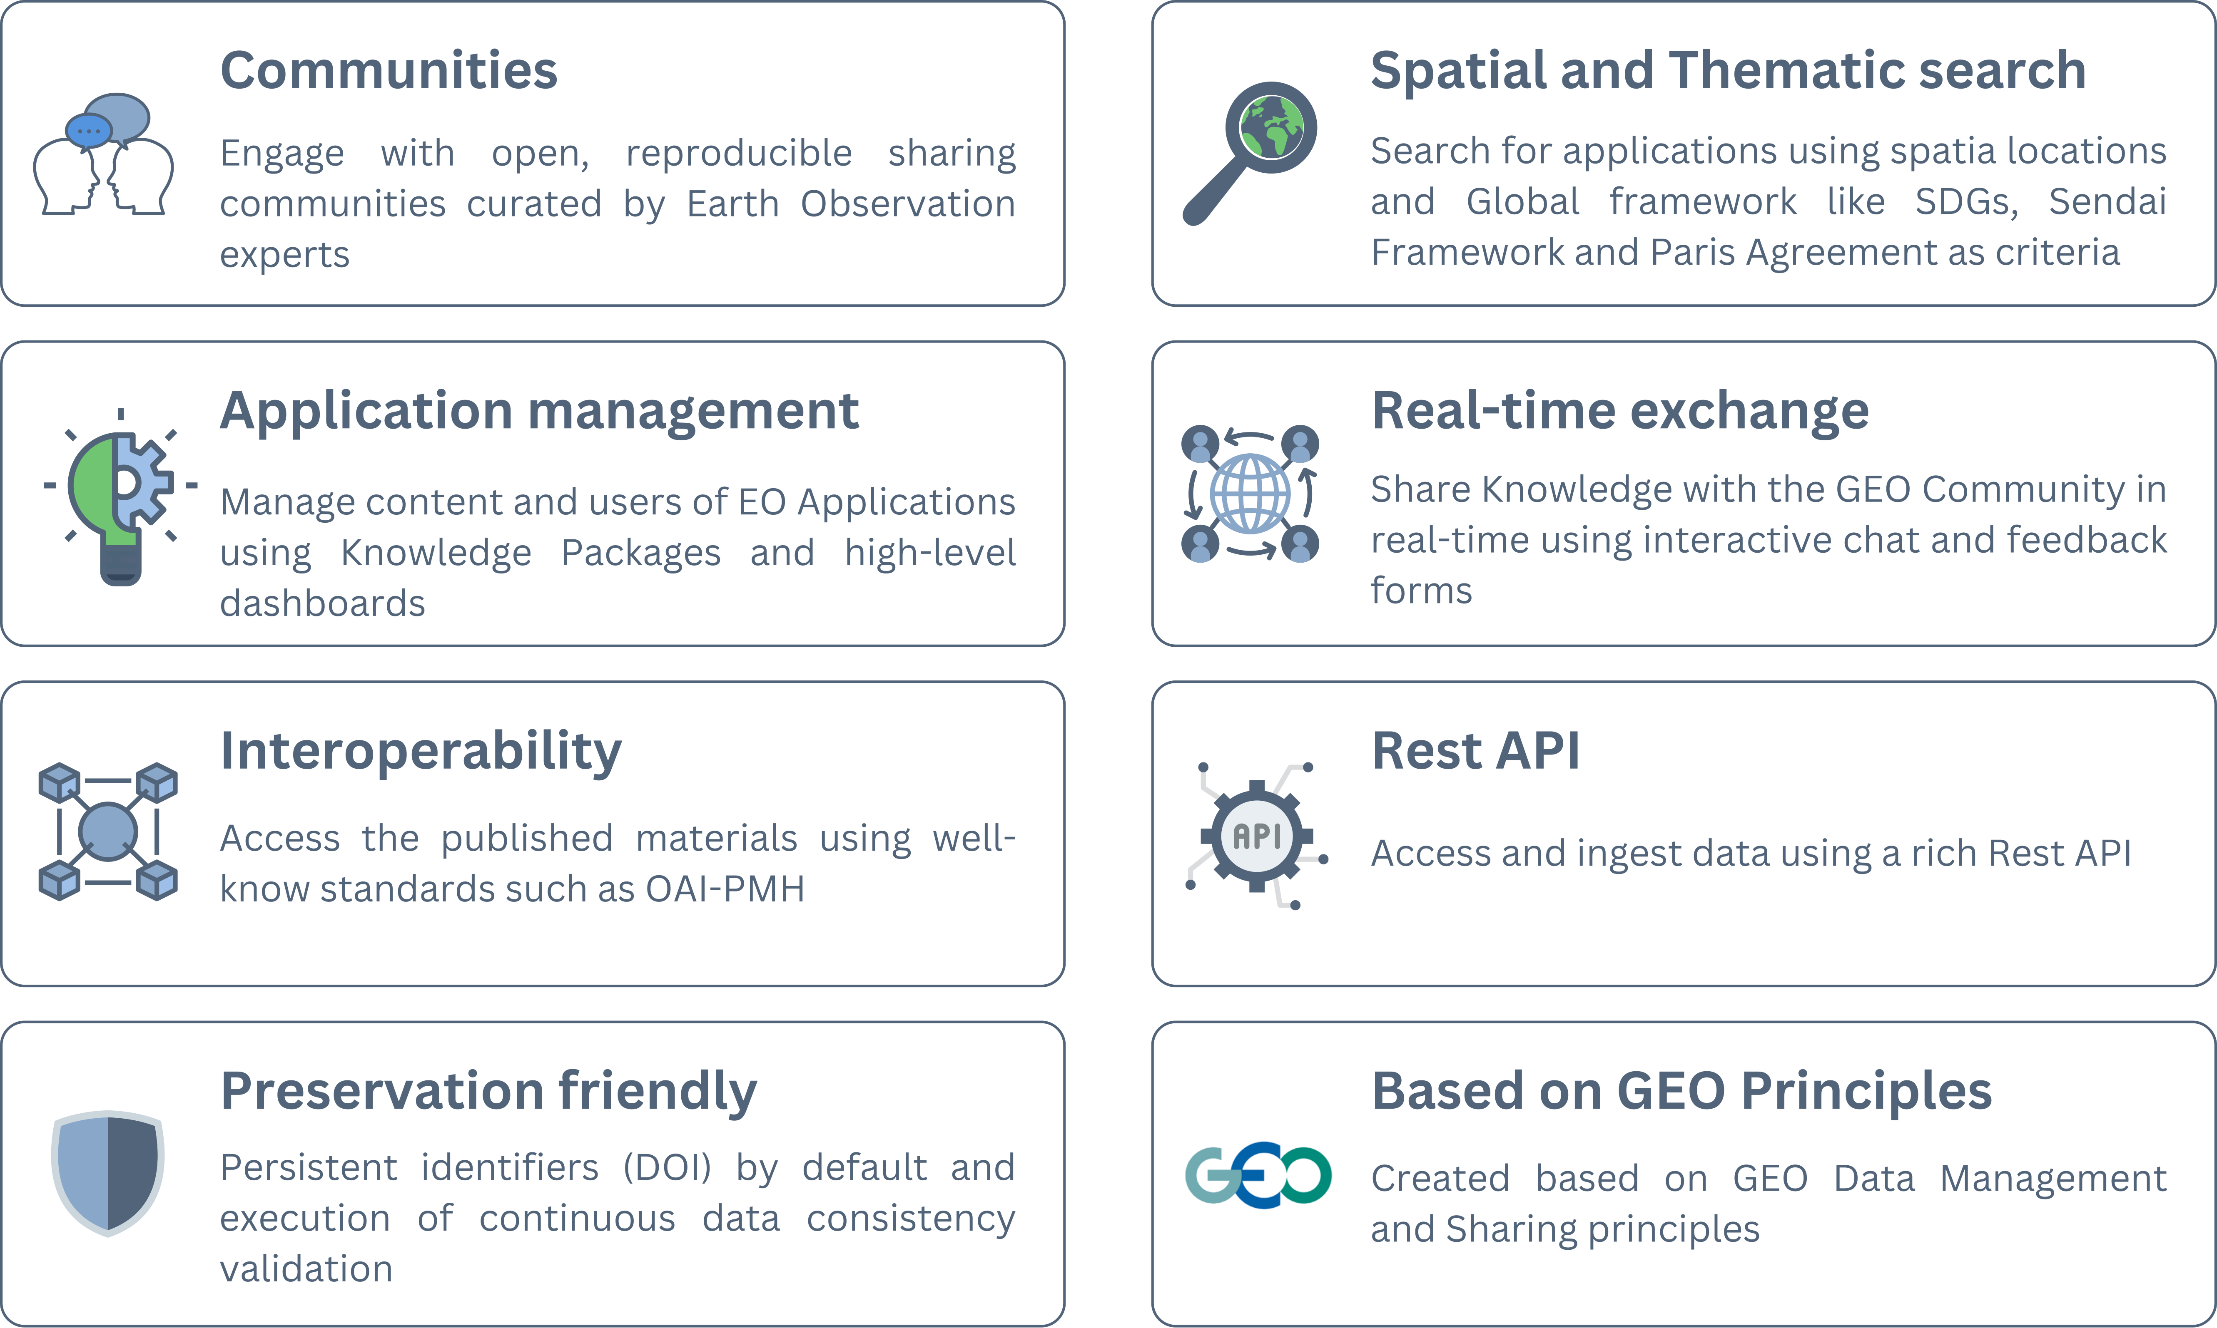
Open Earth Monitor Workshop 2023
GEO Knowledge Hub to preserve and share EO Applications

Slide 47
Thematic
Search
Open Earth Monitor Workshop 2023
GEO Knowledge Hub to preserve and share EO Applications

Slide 48

Engagement priorities
Thematic
Search
Open Earth Monitor Workshop 2023
GEO Knowledge Hub to preserve and share EO Applications

Slide 49

Engagement priorities
Thematic
Search
Conventions
Open Earth Monitor Workshop 2023
GEO Knowledge Hub to preserve and share EO Applications

Slide 50
Spatial
Search
Open Earth Monitor Workshop 2023
GEO Knowledge Hub to preserve and share EO Applications

Slide 51
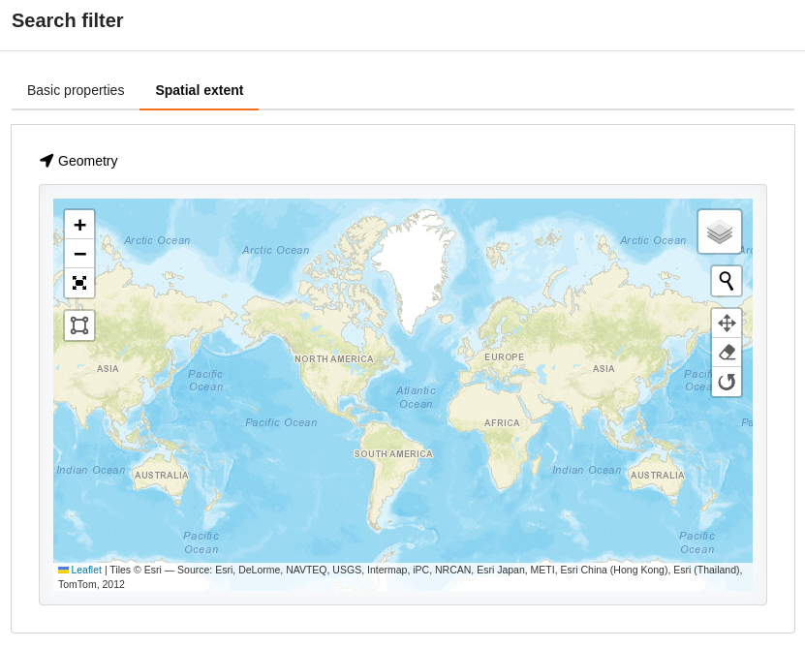
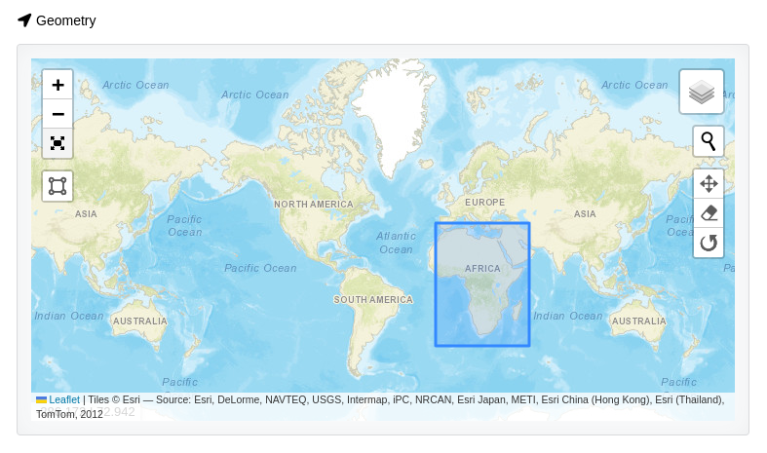
Spatial
Search
Open Earth Monitor Workshop 2023
GEO Knowledge Hub to preserve and share EO Applications

Slide 52

Communities
Open Earth Monitor Workshop 2023
GEO Knowledge Hub to preserve and share EO Applications

Slide 53
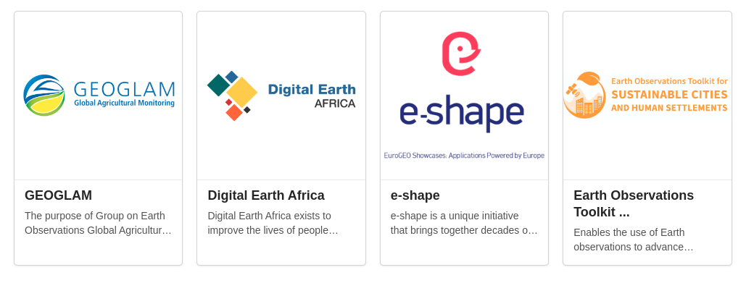
Communities
Open Earth Monitor Workshop 2023
GEO Knowledge Hub to preserve and share EO Applications

Slide 54
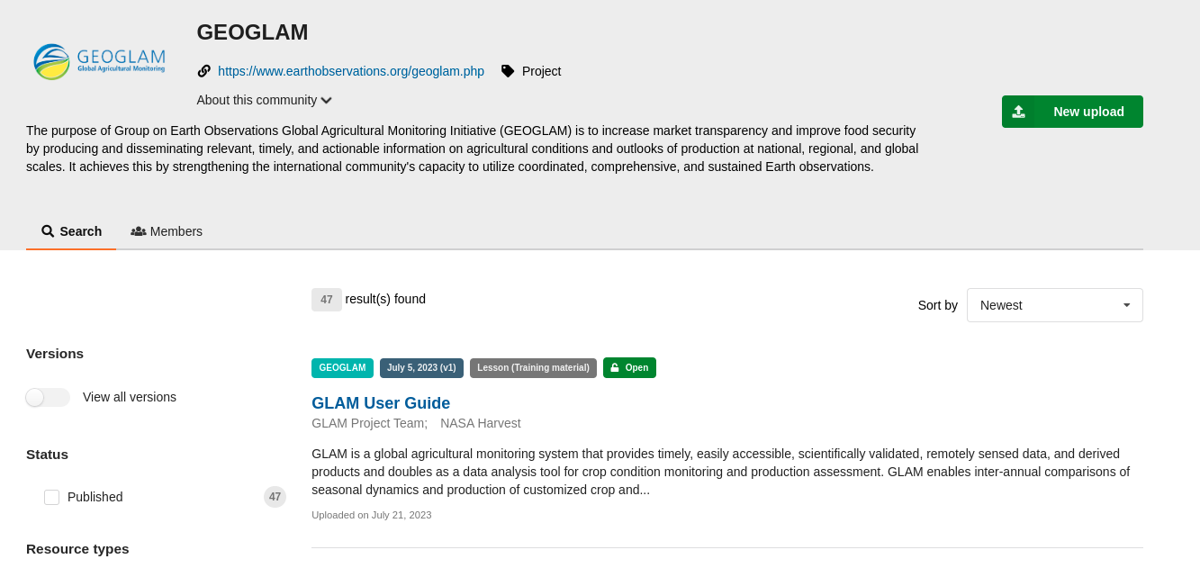
Communities
Open Earth Monitor Workshop 2023
GEO Knowledge Hub to preserve and share EO Applications

Slide 55
Knowledge Package page
Open Earth Monitor Workshop 2023
GEO Knowledge Hub to preserve and share EO Applications

Slide 56
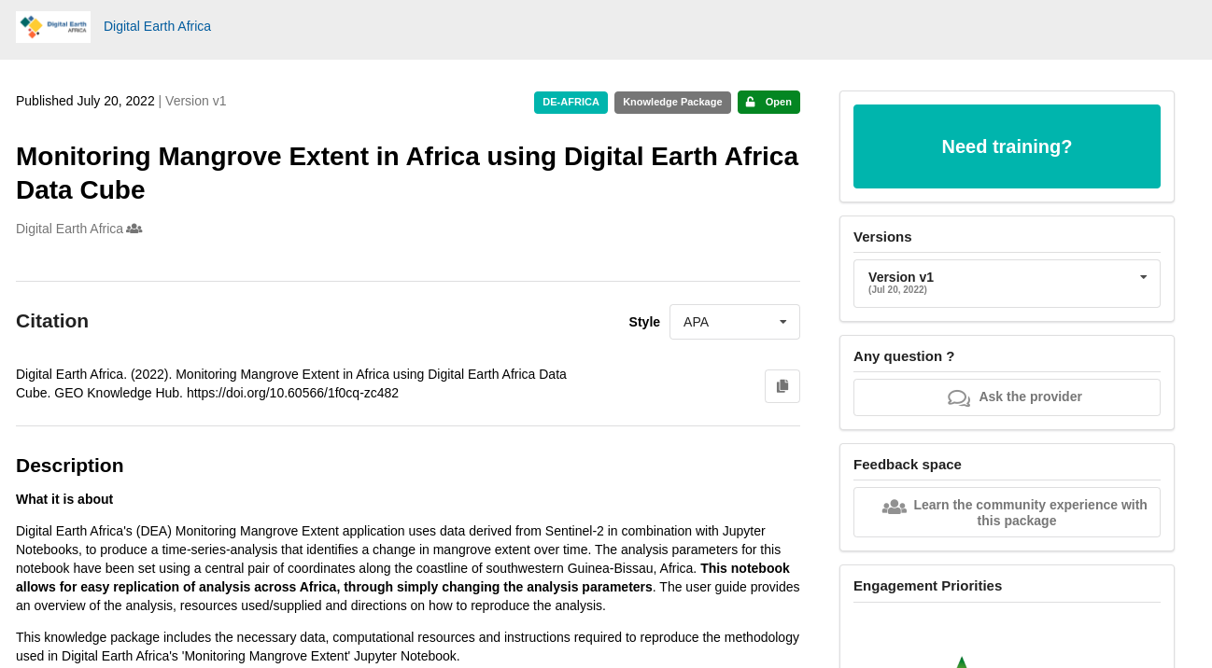
Knowledge Package page
Open Earth Monitor Workshop 2023
GEO Knowledge Hub to preserve and share EO Applications

Slide 57
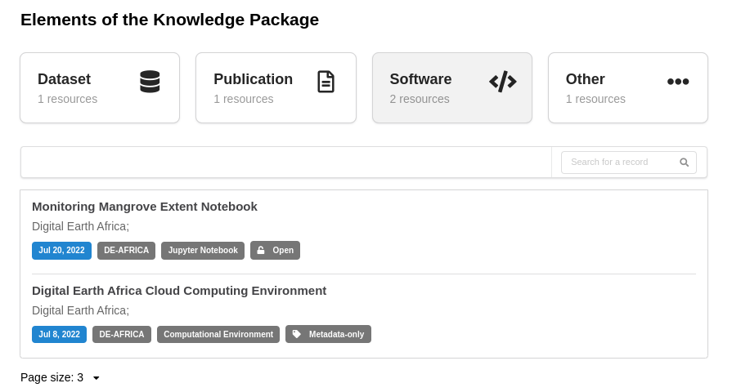
Knowledge Package page
Open Earth Monitor Workshop 2023
GEO Knowledge Hub to preserve and share EO Applications

Slide 58
Real-time exchange
Open Earth Monitor Workshop 2023
GEO Knowledge Hub to preserve and share EO Applications

Slide 59
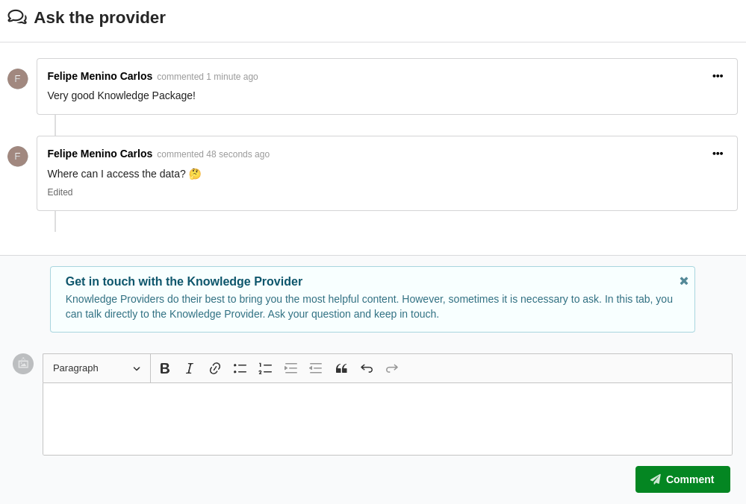
Real-time exchange
Open Earth Monitor Workshop 2023
GEO Knowledge Hub to preserve and share EO Applications

Slide 60
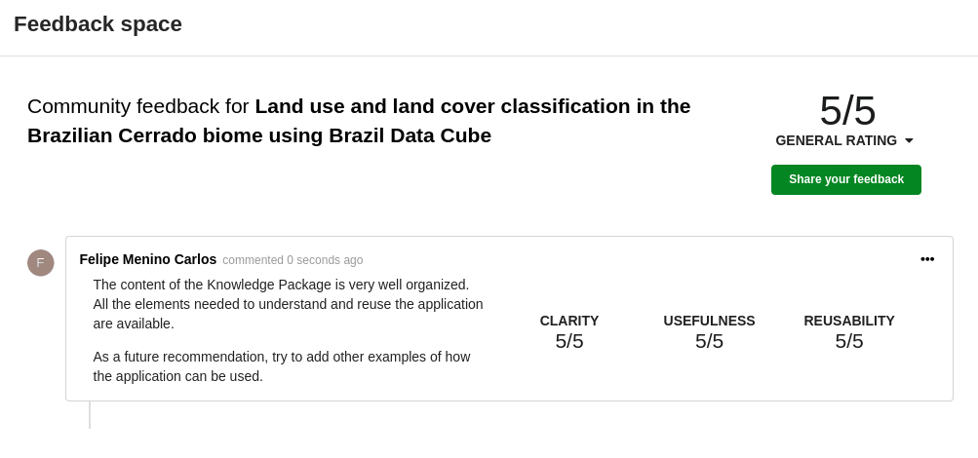
Real-time exchange
Open Earth Monitor Workshop 2023
GEO Knowledge Hub to preserve and share EO Applications

Slide 61
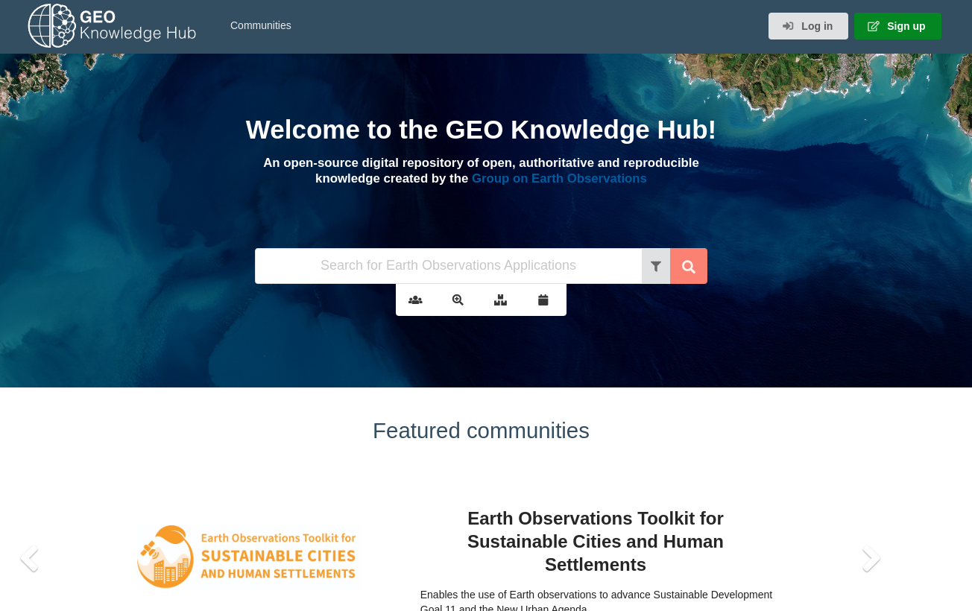
gkhub.earthobservations.org
Practical demonstration
Open Earth Monitor Workshop 2023
GEO Knowledge Hub to preserve and share EO Applications

Slide 62
Questions ?
Open Earth Monitor Workshop 2023
GEO Knowledge Hub to preserve and share EO Applications

Slide 63
Knowledge Package creation page
Open Earth Monitor Workshop 2023
GEO Knowledge Hub to preserve and share EO Applications

Slide 64
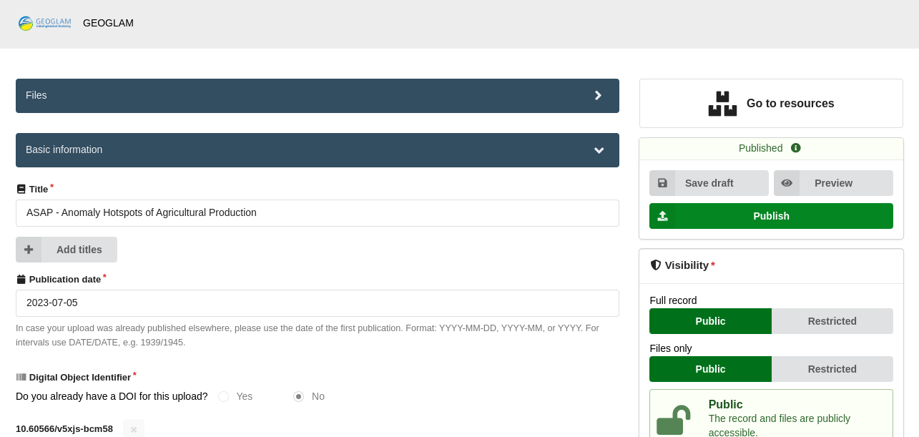
Knowledge Package creation page
Open Earth Monitor Workshop 2023
GEO Knowledge Hub to preserve and share EO Applications

Slide 65
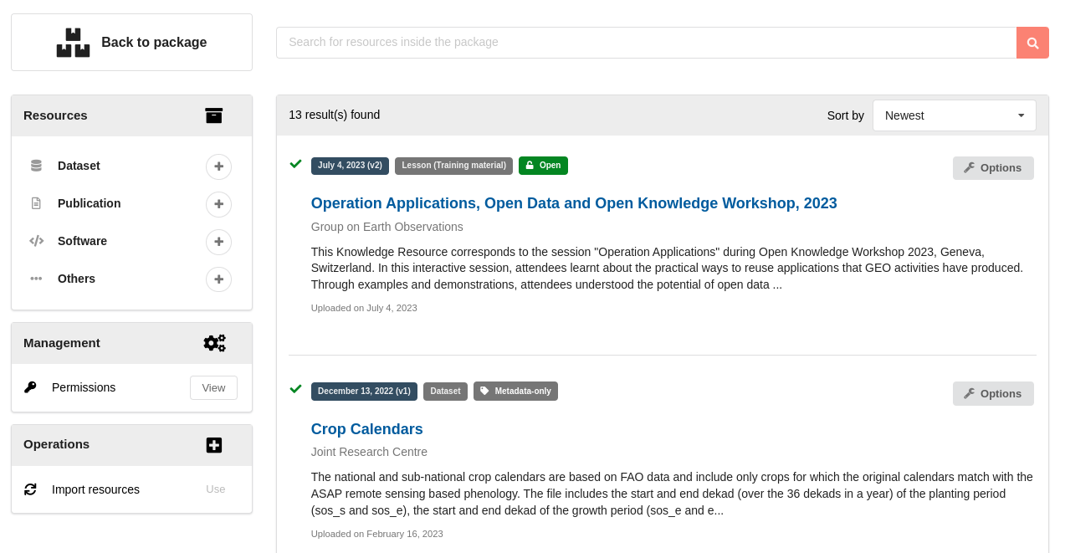
Knowledge Package creation page
Open Earth Monitor Workshop 2023
GEO Knowledge Hub to preserve and share EO Applications

Slide 66

Digital Object Identifier (DOI) creation
Open Earth Monitor Workshop 2023
GEO Knowledge Hub to preserve and share EO Applications

Slide 67
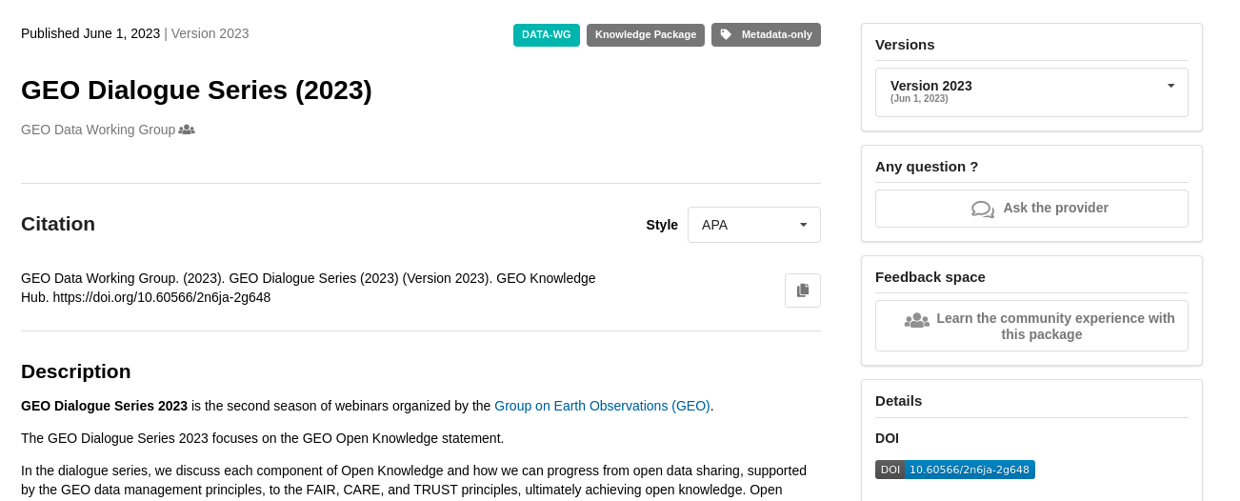
Digital Object Identifier (DOI) creation
Knowledge Package
10.60566/2n6ja-2g648
Open Earth Monitor Workshop 2023
GEO Knowledge Hub to preserve and share EO Applications

Slide 68
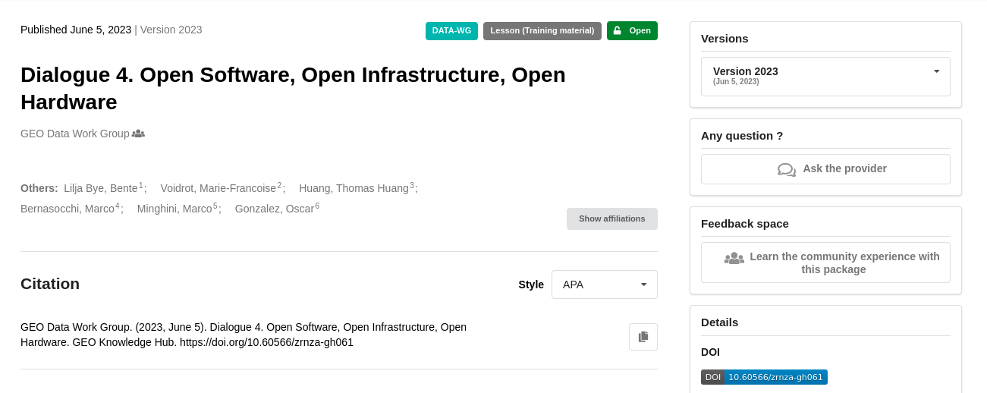
Digital Object Identifier (DOI) creation
Knowledge Package
Resources
10.60566/2n6ja-2g648
10.60566/zrnza-gh061
Open Earth Monitor Workshop 2023
GEO Knowledge Hub to preserve and share EO Applications

Slide 69
GEO Knowledge Hub Feed
Open Earth Monitor Workshop 2023
GEO Knowledge Hub to preserve and share EO Applications

Slide 70
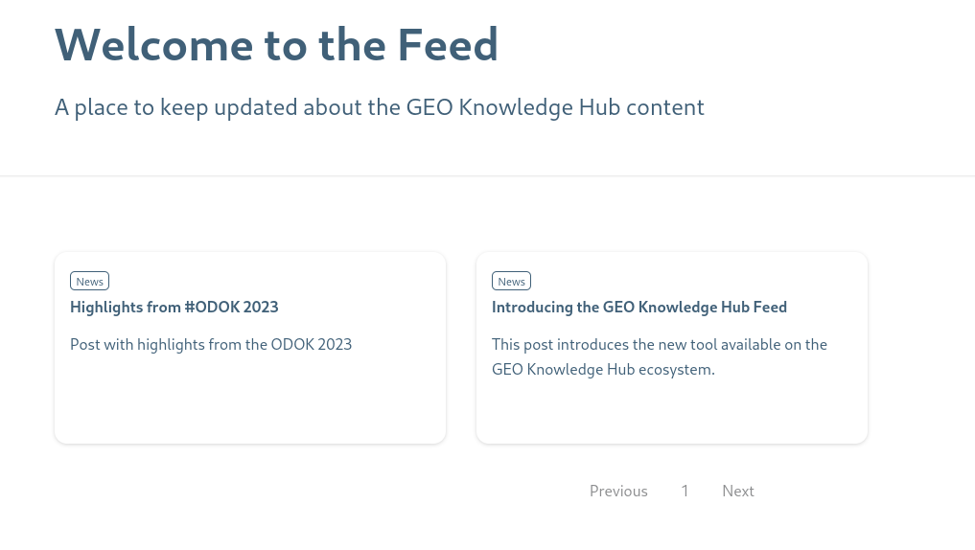
GEO Knowledge Hub Feed
gkhub.earthobservations.org/feed
Open Earth Monitor Workshop 2023
GEO Knowledge Hub to preserve and share EO Applications

Slide 71
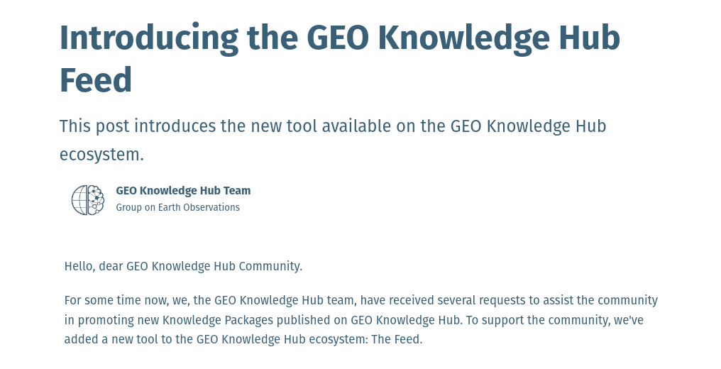
GEO Knowledge Hub Feed
gkhub.earthobservations.org/feed
Open Earth Monitor Workshop 2023
GEO Knowledge Hub to preserve and share EO Applications

Slide 72
User Dashboard
Open Earth Monitor Workshop 2023
GEO Knowledge Hub to preserve and share EO Applications

Slide 73
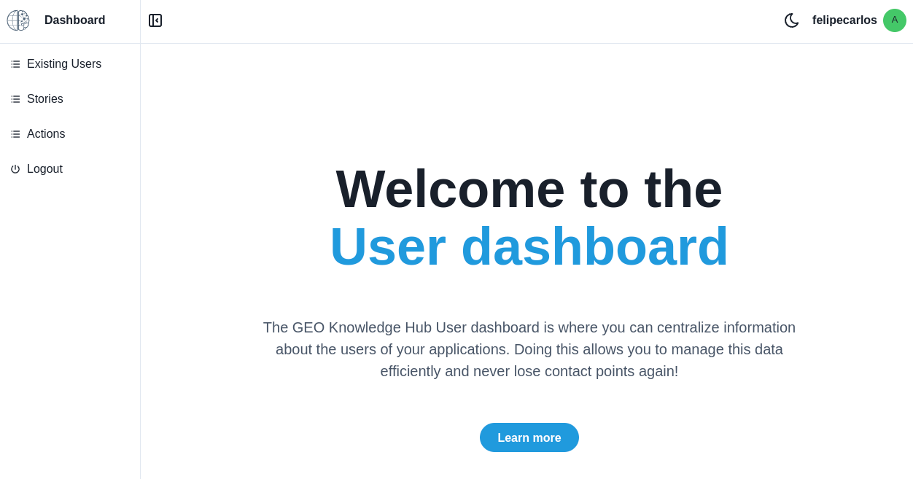
User Dashboard
Open Earth Monitor Workshop 2023
GEO Knowledge Hub to preserve and share EO Applications

Slide 74
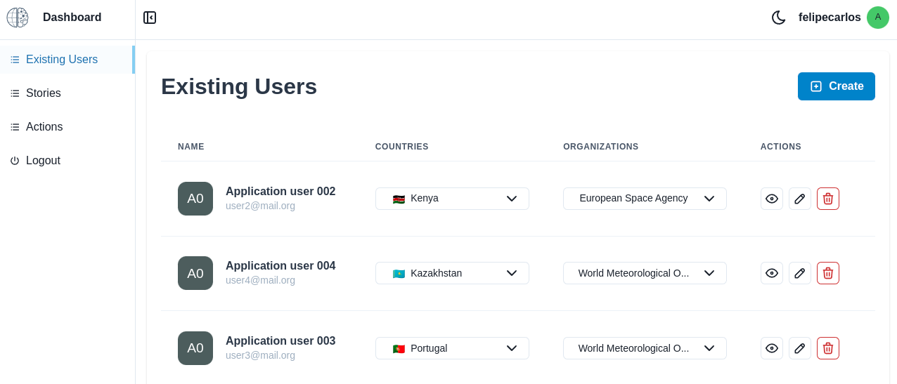
User Dashboard
Open Earth Monitor Workshop 2023
GEO Knowledge Hub to preserve and share EO Applications

Slide 75
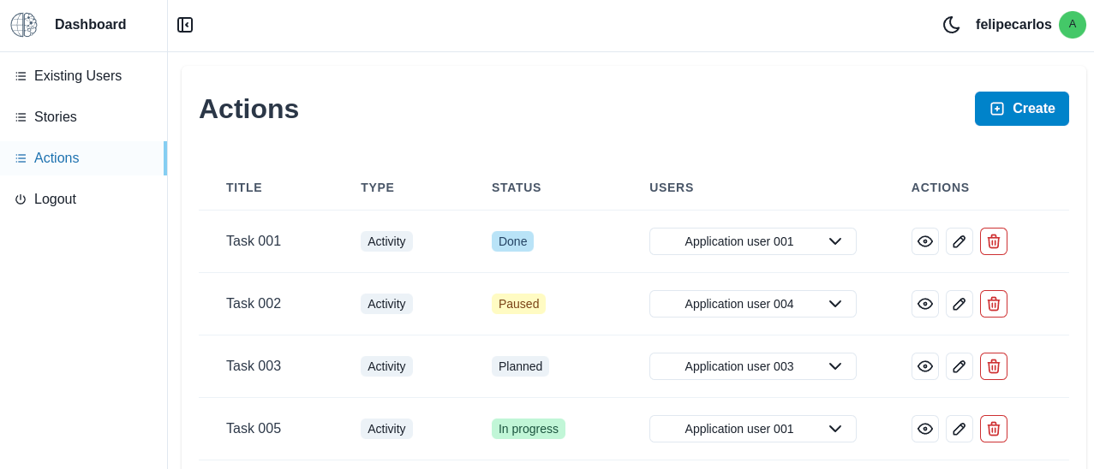
User Dashboard
Open Earth Monitor Workshop 2023

Slide 76
gkhub.earthobservations.org
Practical demonstration
Open Earth Monitor Workshop 2023
GEO Knowledge Hub to preserve and share EO Applications

Slide 77
Questions ?
Open Earth Monitor Workshop 2023
GEO Knowledge Hub to preserve and share EO Applications

Slide 78
Rest API
Open Earth Monitor Workshop 2023
GEO Knowledge Hub to preserve and share EO Applications

Slide 79
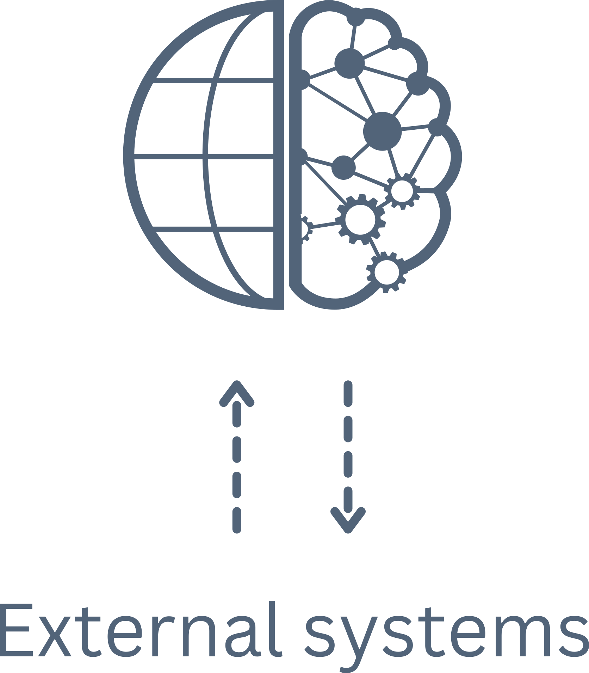
Rest API
Open Earth Monitor Workshop 2023
GEO Knowledge Hub to preserve and share EO Applications

Slide 80
Rest API
Bulk Package Loader
Open Earth Monitor Workshop 2023
GEO Knowledge Hub to preserve and share EO Applications

Slide 81
Rest API
Bulk Package Loader
OGC/CSW Package Loader
(Harvester)
Open Earth Monitor Workshop 2023
GEO Knowledge Hub to preserve and share EO Applications

Slide 82
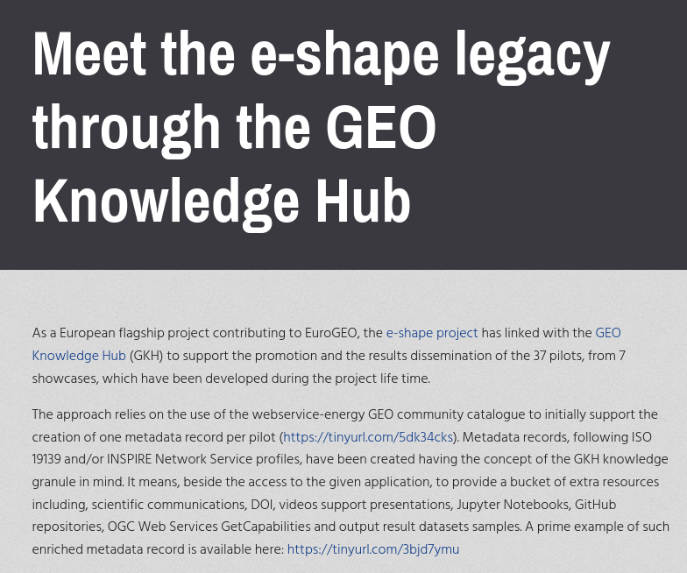
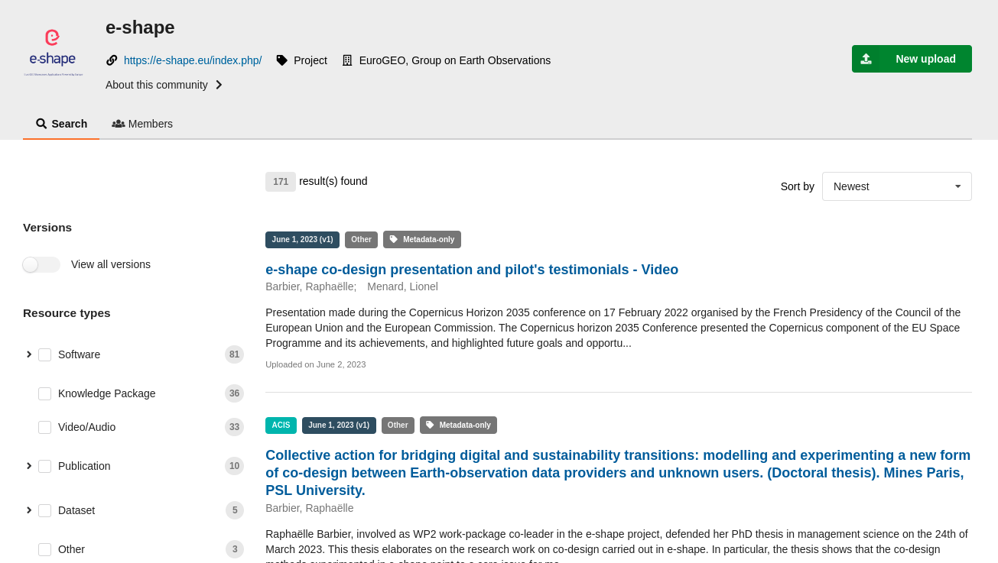
Using the Rest API
tinyurl.com/e-shape-gkh
Open Earth Monitor Workshop 2023
gkhub.earthobservations.org/communities/e-shape

Slide 83

Using the Rest API
Open Earth Monitor Workshop 2023
GEO Knowledge Hub to preserve and share EO Applications

Slide 84
Using the Rest API
Detecting deforestation using data cubes and deep learning
Open Earth Monitor Workshop 2023
GEO Knowledge Hub to preserve and share EO Applications

Slide 85




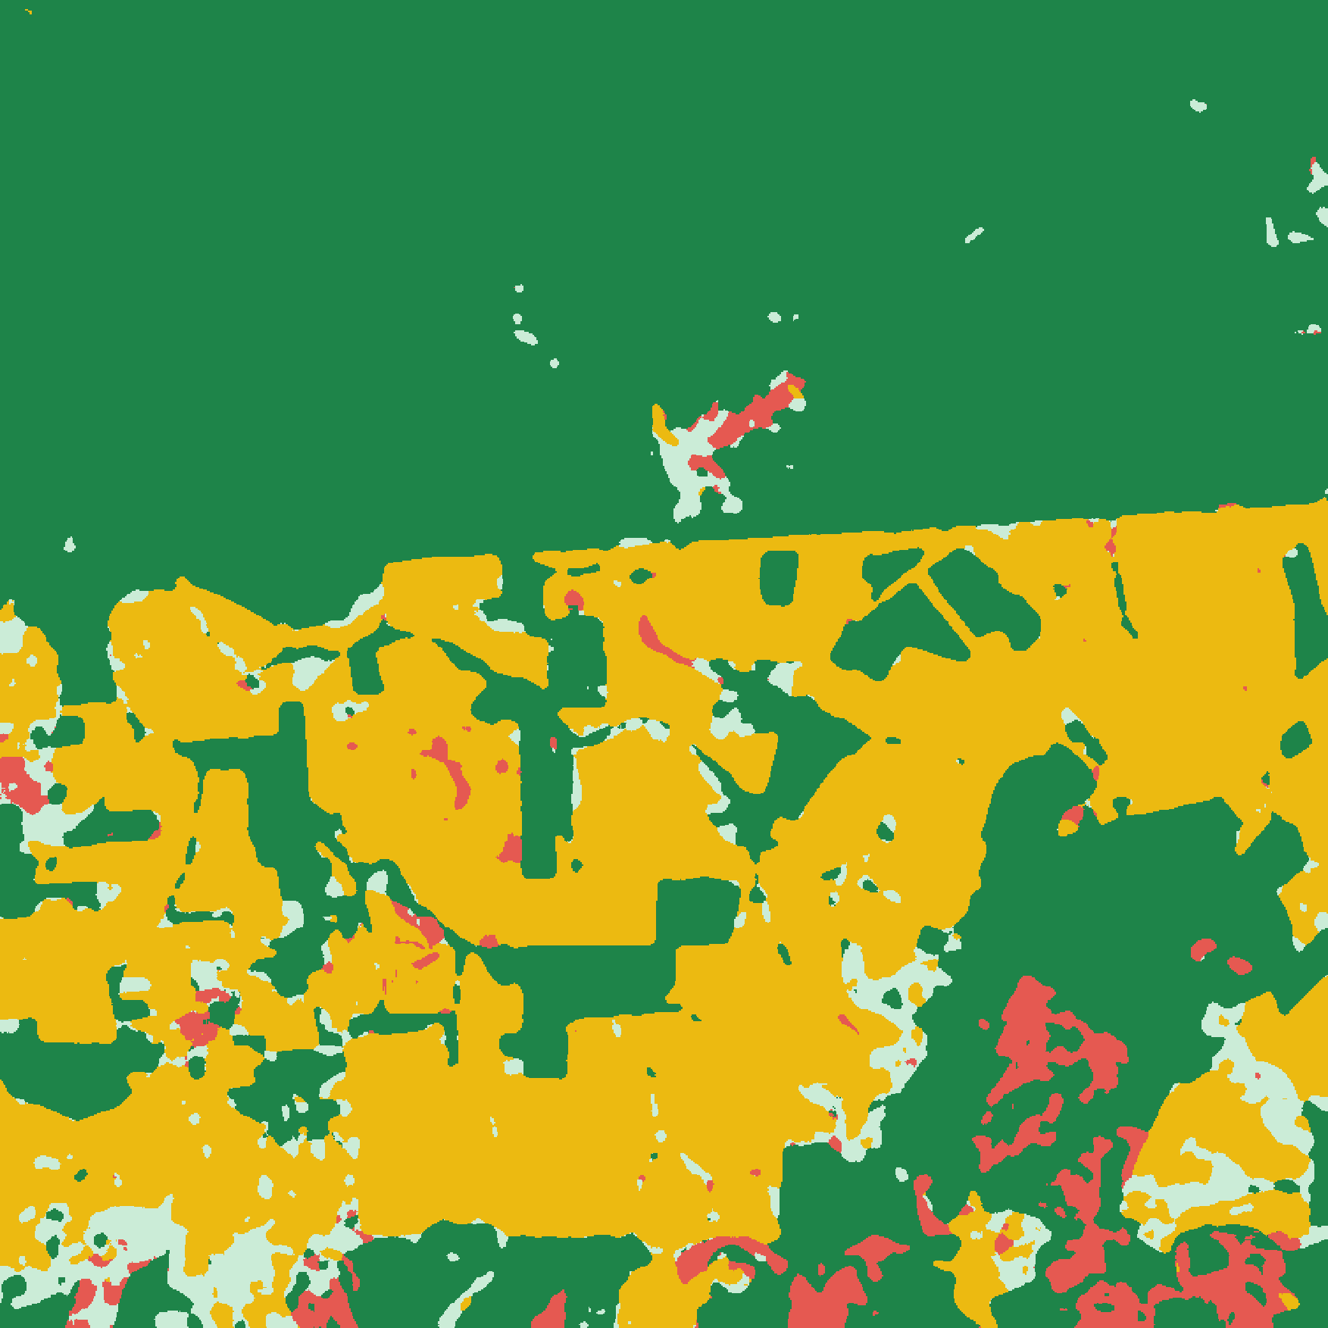




Using the Rest API
Detecting deforestation using data cubes and deep learning
Processing scripts
Data Cube and samples
Machine Learning Model
Deforestation map
Processing environment
Complementary files
Usage workflow

Slide 86
Using the Rest API
Detecting deforestation using data cubes and deep learning
Usage workflow

Slide 87
Using the Rest API
Detecting deforestation using data cubes and deep learning
Using the GEO Knowledge Hub Rest API, in the workflow are available routines to configure and execute the processing scripts automatically
Usage workflow

Slide 88
Documentation
Open Earth Monitor Workshop 2023
GEO Knowledge Hub to preserve and share EO Applications

Slide 89
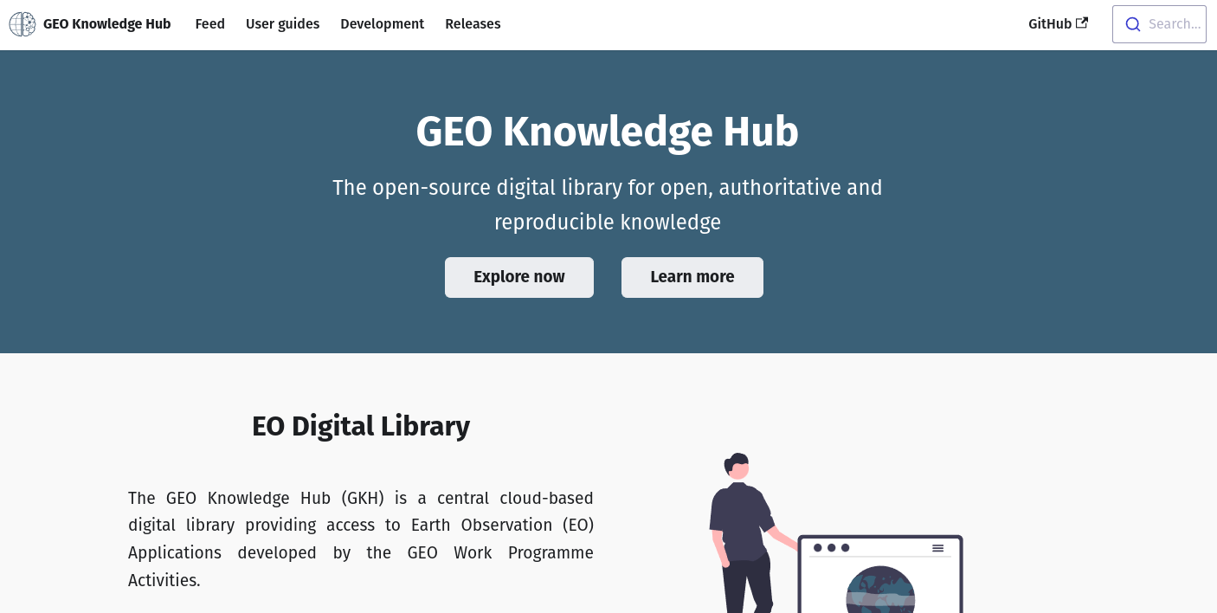
Documentation
gkhub.earthobservations.org/doc
Open Earth Monitor Workshop 2023
GEO Knowledge Hub to preserve and share EO Applications

Slide 90
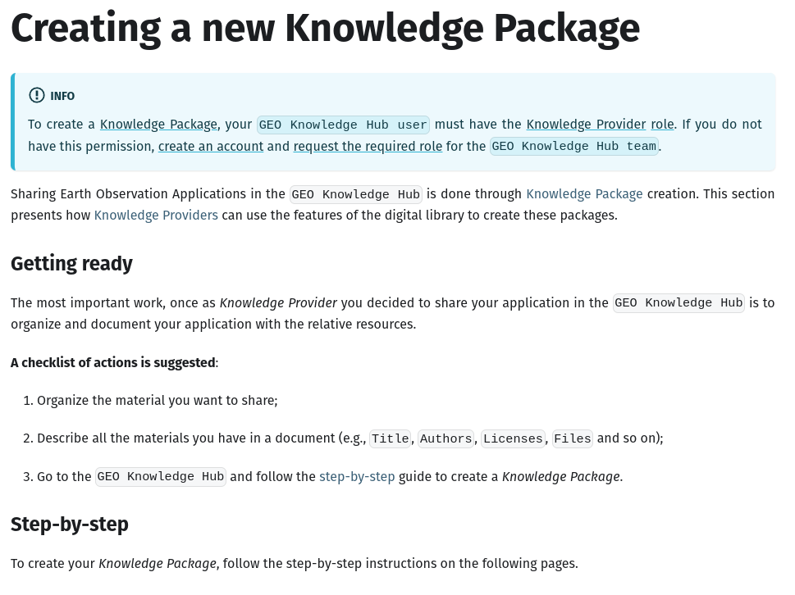
Documentation
gkhub.earthobservations.org/doc
Open Earth Monitor Workshop 2023
GEO Knowledge Hub to preserve and share EO Applications

Slide 91
Open-source platform
Open Earth Monitor Workshop 2023
GEO Knowledge Hub to preserve and share EO Applications

Slide 92


Open-source platform
github.com/geo-knowledge-hub
Open Earth Monitor Workshop 2023
GEO Knowledge Hub to preserve and share EO Applications

Slide 93

Open-source platform
github.com/geo-knowledge-hub
Open Earth Monitor Workshop 2023
GEO Knowledge Hub to preserve and share EO Applications

Slide 94









Tech stack
Docusaurus
Flask
Python
Semantic UI
React

Slide 95




Infrastructure
Amazon Elastic Compute Cloud
EC2
Amazon Simple Storage Service
S3
Amazon Web Services
Amazon Relational Database Service
RDS
Amazon Backup
Backup
Open Earth Monitor Workshop 2023
GEO Knowledge Hub to preserve and share EO Applications

Slide 96
GEO Knowledge Hub content
108
531
Knowledge Packages
Knowledge Resources
Open Earth Monitor Workshop 2023
GEO Knowledge Hub to preserve and share EO Applications

Slide 97

GEO Knowledge Hub content
Open Earth Monitor Workshop 2023
GEO Knowledge Hub to preserve and share EO Applications

Slide 98

GEO Community access
~21.000 views
(in the last 10 months)
Visitors by country
(Stronger color means more visitors)
Note: Metrics are collected with Plausible, a privacy-friendly tool
(GDPR, CCPA, PECR compliant tool)
Open Earth Monitor Workshop 2023
GEO Knowledge Hub to preserve and share EO Applications

Slide 99
Future steps
Open Earth Monitor Workshop 2023
GEO Knowledge Hub to preserve and share EO Applications

Slide 100
Future steps
Engage with GEO Work Programme activities not yet in the GEO Knowledge Hub
Open Earth Monitor Workshop 2023
GEO Knowledge Hub to preserve and share EO Applications

Slide 101
Future steps
Engage with GEO Work Programme activities not yet in the GEO Knowledge Hub
Increase the EO applications available in the digital library
Open Earth Monitor Workshop 2023
GEO Knowledge Hub to preserve and share EO Applications

Slide 102
Future steps
Engage with GEO Work Programme activities not yet in the GEO Knowledge Hub
Increase the EO applications available in the digital library
Webinars on available Knowledge Packages
Open Earth Monitor Workshop 2023
GEO Knowledge Hub to preserve and share EO Applications

Slide 103

Future steps
Make new features available
Open Earth Monitor Workshop 2023
GEO Knowledge Hub to preserve and share EO Applications

Slide 104
Thank you

